Slide 1

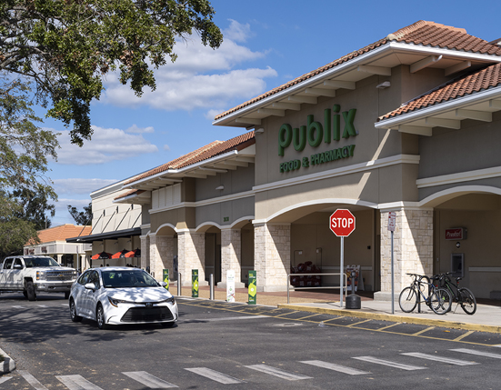

Buffalo Rise Development
Britton Plaza
Brixmor Property Group
ICSC Foundation Case Competition 2025
Notes:
We are Buffalo Rise Development and We are super excited to present to you the redevelopment of Britton Plaza.

Slide 2
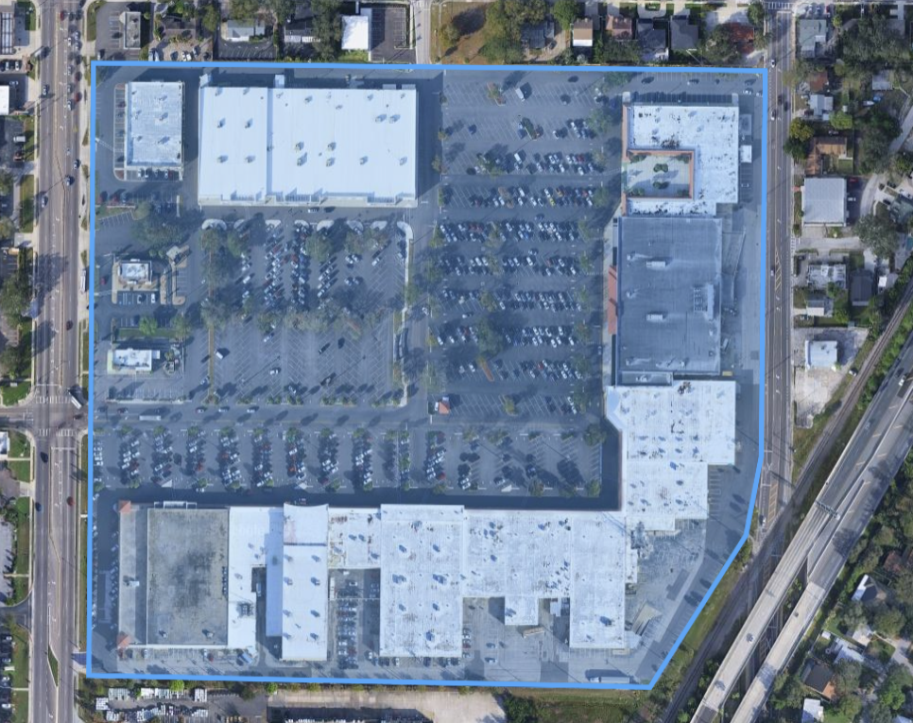
Site Overview
Britton Plaza
Site Specs
Lot Size: 31.9 acres
Total GLA: 460,000 Sq Ft
Anchors: 217,000 Sq Ft
Investment Plan
Redevelop the center into a walkable, community-oriented destination by repositioning underperforming tenants
Project Analysis
Current NOI: $2,566,164
Post-Project NOI: $4,690,879
15-Year MOIC: 5.58x
Britton Plaza
Buffalo Rise Development

Slide 3


Key Stakeholders
Brixmor (BRX)
Anchor Tenants
Community-driven retail REIT
Focus on long-term reinvestment
Value: Community serving retail space with sustainability and balanced growth
Goal: Reinvest to maximize community connectivity within the shopping center
Control redevelopment feasibility
Drive most of the consumer traffic
Working as partners to help improve plan visibility and consumer flow
Losing anchor support risks legal issues and loss of overall property value
Buffalo Rise Development
Notes:
The case gave us a couple key stakeholder. First is brixmor the owner of the property, they focus on open air shopping centers with a community focus which is what we hope to create here. There shopping centers are always anchored by large tenants who are also stakeholders in this case. Our goal is to negotiate and work with the anchor tenants to provide the best outcome for all parties involved.

Slide 4
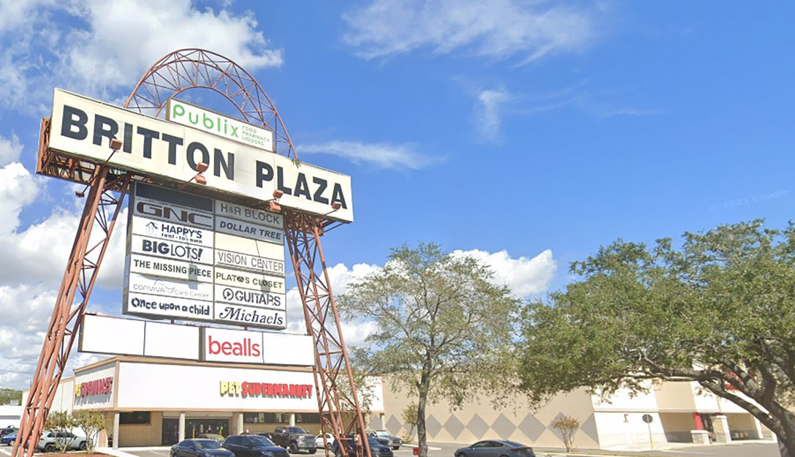
Agenda
Market Overview
Development Plan
Financials
Risk Analysis
Final Recommendation
Buffalo Rise Development

Slide 5
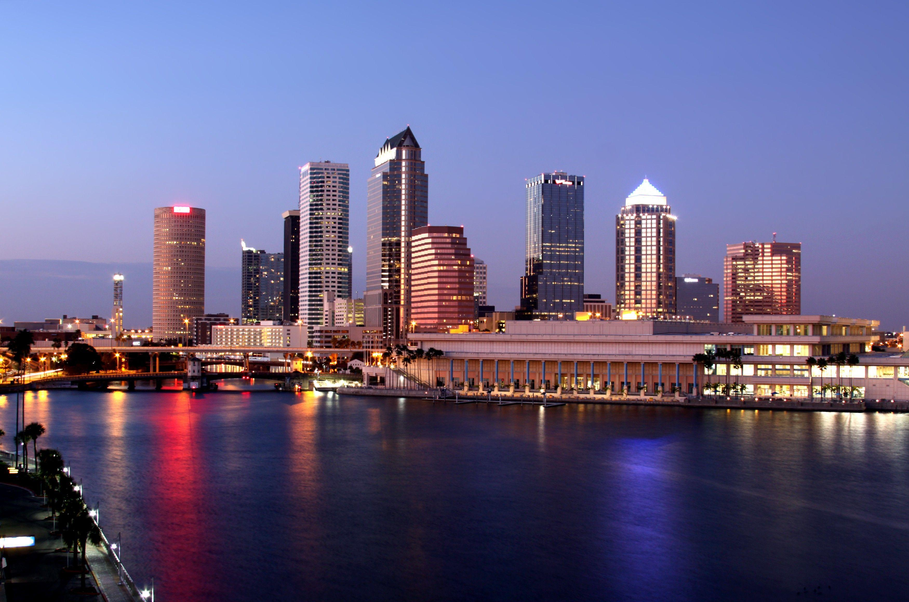
Market Research
Buffalo Rise Development

Slide 6

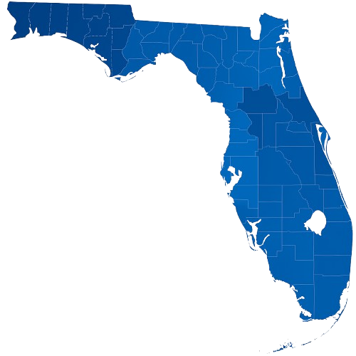

Market Research
Demographics | State
Florida
3rd
Florida is the 3rd most populous U.S. state and continues to grow rapidly, attracting both residents and business
$250B
Florida's retail sales exceed $250 billion annually, supported by the tourism, a growing middle class, and spending
$73K
The median household income is $73,000, showing continued wage growth and above average discretionary spending power
0
With no state income tax, steady job growth, and pro-development regulations, Florida encourages retail investment and asset redevelopment
Buffalo Rise Development

Slide 7


Market Research
Demographics | City
Tampa, Fl
3.7%
Tampa’s retail vacancy remains below the national average at 3.7%, signaling limited supply and strong retention
Tampa, Fl
$28.50
Rents have risen steadily at an average price of $28.50 per square foot as demand outpaces new construction, reflecting the area’s customer base
4.8%
Tampa ranks among Florida's top performing retail markets, with +4.8% YoY rent growth and expanding foods fitness, and apparel brands
Hillsborough County
$79K
With the median local income being $ 79,000 and growing population density support elevated spending and opportunities for elevated tenant mix
Buffalo Rise Development

Slide 8
Market Research
Demographics | Britton Plaza
Tampa Consumer Habits
(3-Mile Radius)
Population (3-Mile Radius): 96,124
Daytime Population: 96,967
Average Household Income: $171,804
Median Home Value: $681,944
College Educated (4+ years): 62.2%
Weekly Spending per capita: $467
16%
18%
43%
7%
16%
Buffalo Rise Development

Slide 9
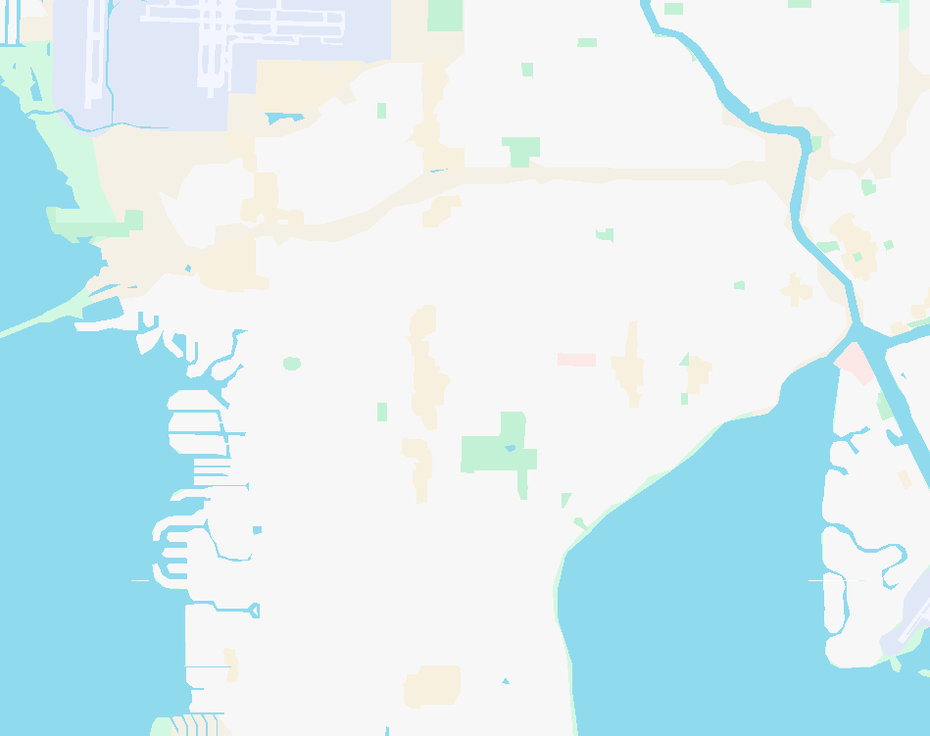







Market Research
Comparable Properties
1
HYDE PARK VILLAGE
Upper-End Tenant Mix
2
Year Built: 1985
GLA: 264,410
Vacancy: 0%
1
2
WALTERS CROSSING
More Everyday Shopping
Year Built: 1994
GLA: 453,349
Vacancy: 0%
Britton
Buffalo Rise Development

Slide 10
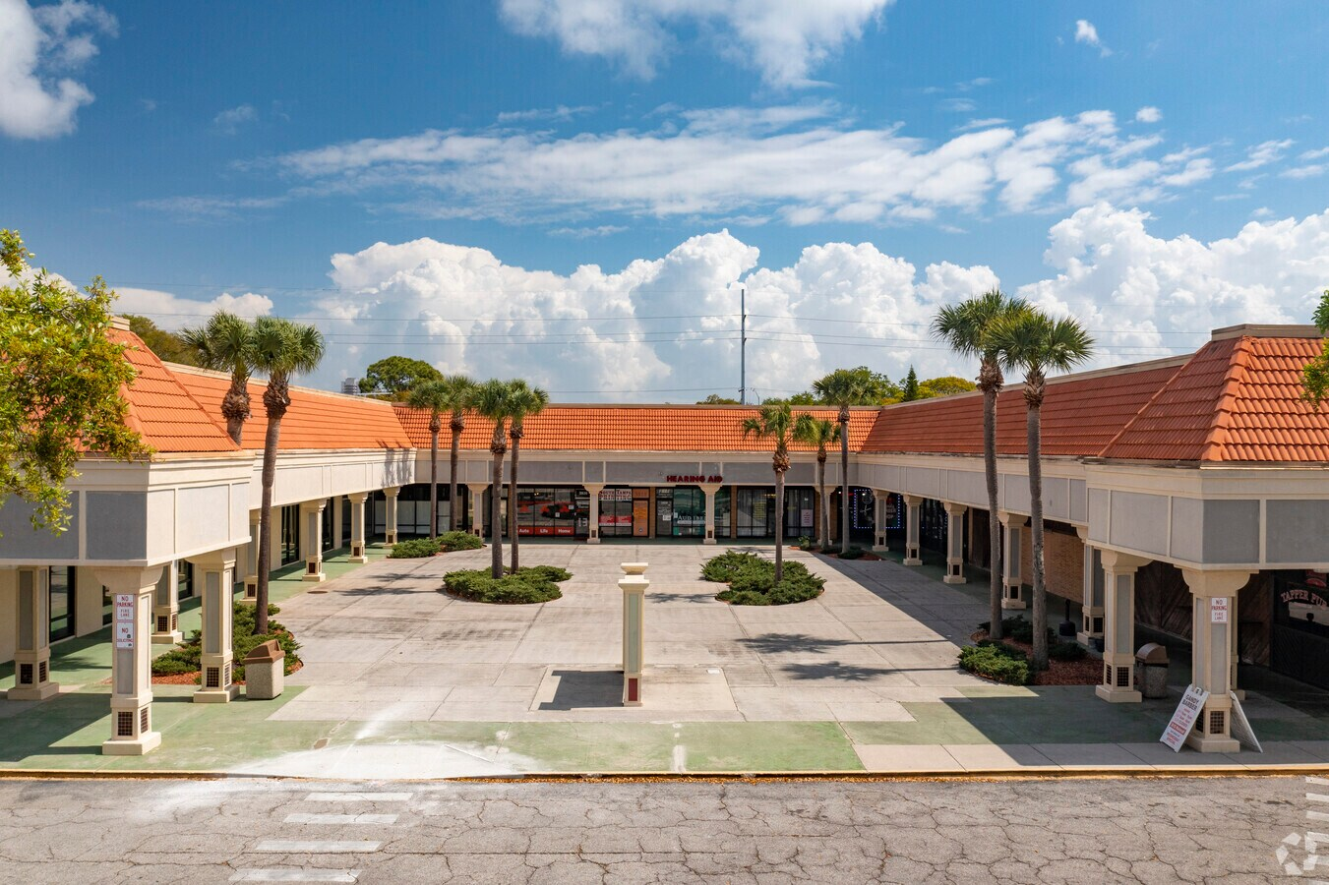
Development Plan
Buffalo Rise Development

Slide 11
Development Plan
Site Alternatives
Retail Re-Merchandising
Phased Mixed-Use
Hybrid Lifestyle Center
Pros:
Pros:
Pros:
No large construction project costs
Plaza diversification by mixing new and old tenants
NOI growth through less vacancy
NOI growth potential from multifamily development
Creates a new community in the South Tampa area
Allows plaza to be used as a gathering space for Tampa residents
Creating a more inviting environment for more foot traffic
Cons:
Cons:
Cons:
Leaves lots of empty space where new construction could be created
Leaving plaza as is without adding incentive for increased attraction Lacks community and experiential activation components
Large construction projects delaying potential income from residents and tenants
Latest stabilization period amongst all options
Lack of multifamily income portrayed in phased mixed-use option
Large construction projects similar to phased mixed-use option
Final Decision: Redevelopment of Britton Plaza by creating a hybrid lifestyle center and community hub. Adding new construction with new tenants and green space for gatherings.
Buffalo Rise Development

Slide 12
Development Plan
Current Rent Roll Analysis
SUITE TENANT PSF INITIAL LEASE EXP FULL LEASE EXP
3838 Publix $5.25 12/31/2035 12/31/2085
TOWER Crown Castle $3,405 mo 10/31/2024 10/31/2044
3820P Dunkin Donuts $23.53 4/30/2029 4/30/2044
3804A Michaels $12.25 6/30/2028 6/30/2038
3806 Pet Supermarket $11.57 12/31/2026 12/31/2036
3802 Taco Bell $3.13 12/2/2024 12/2/2034
3802D My Salon Suite $16.21 4/30/2029 4/30/2034
3852-3854 Conviva Care Center $12.00 5/31/2027 5/31/2033
3940 Happy’s Rent To Own $14.63 3/31/2026 3/31/2032
3802A Britton Plaza Vision $21.71 1/31/2027 1/31/2032
3822 Skin Science $15.88 9/30/2026 9/30/2031
3950 Burlington $303,000 yr 2/28/2026 2/28/2031
3920 Once Upon a Child $16.50 3/31/2025 3/31/2030
3804B Marshalls $10.00 1/31/2029 1/31/2029
3826A-B Sunset Chiropractic $17.79 11/30/2028 11/30/2028
3830-32 Tapper Pub $23.75 9/30/2028 9/30/2028
3942 Greenberg Dental $19.38 6/30/2028 6/30/2028
3802C H&R Block $20.17 4/30/2026 4/30/2026
Buffalo Rise Development

Slide 13
Development Plan
Current Rent Roll Analysis
SUITE TENANT PSF INITIAL LEASE EXP FULL LEASE EXP
3908 Dollar Tree $9.50 4/30/2026 4/30/2026
3925 Plato’s Closet $17.50 4/30/2026 4/30/2026
3904-3906 Tampa Buffet $11.75 4/30/2026 4/30/2026
3816-3836 Tampa Shoe Repair $26.45 3/31/2026 3/31/2026
3944 Replay Music Exchange $24.67 2/28/2026 2/28/2026
3930-3936-3938 Radiant Church $9.50 12/31/2025 12/31/2025
3824 Gandy Barber Shop $20.00 8/31/2025 8/31/2025
3914 Play It Again Sports $19.33 8/31/2025 8/31/2025
3802B-2 New Level Dance Company $11.46 7/31/2025 7/31/2025
3932 A.M. Fit Stop $21.36 7/31/2025 7/31/2025
3934 Cell-Dr $32.59 6/30/2025 6/30/2025
3912 Nail Salon $20.50 4/30/2025 4/30/2025
3848B The Missing Piece $12.50 4/30/2025 4/30/2025
3818 South Tampa Printing $17.00 1/31/2025 1/31/2025
3918A GNC $21.90 10/31/2024 10/31/2024
3820 Audibel Hearing Aid Center $45.71 12/31/2023 12/31/2023
3802B-1 Entertainment Foundation $11.50 8/31/2024 8/31/2024
BILLBOARD Outfront Media $1,650 mo 3/31/2023 3/31/2023
Buffalo Rise Development

Slide 14
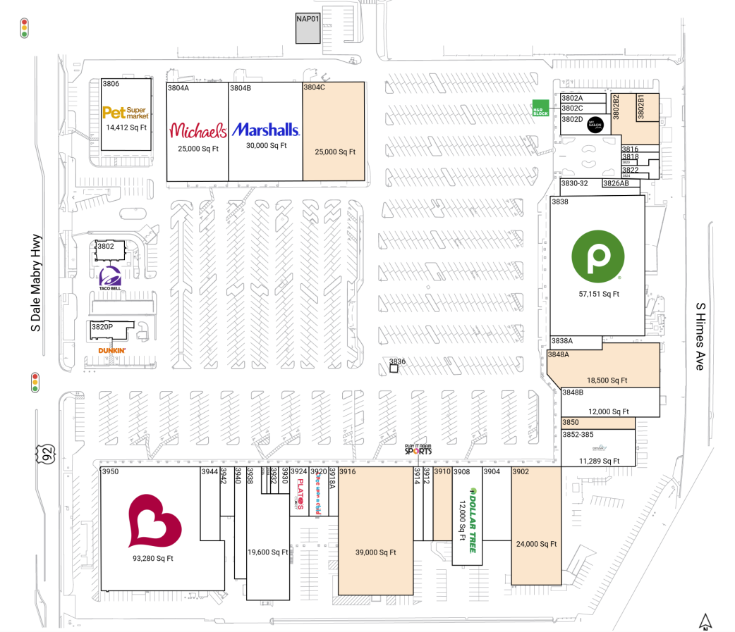
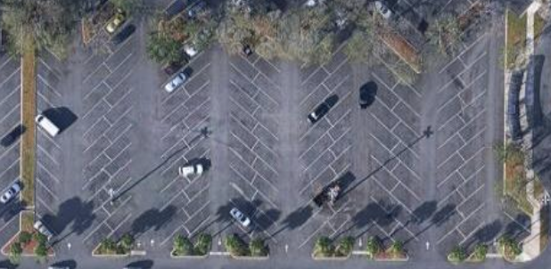
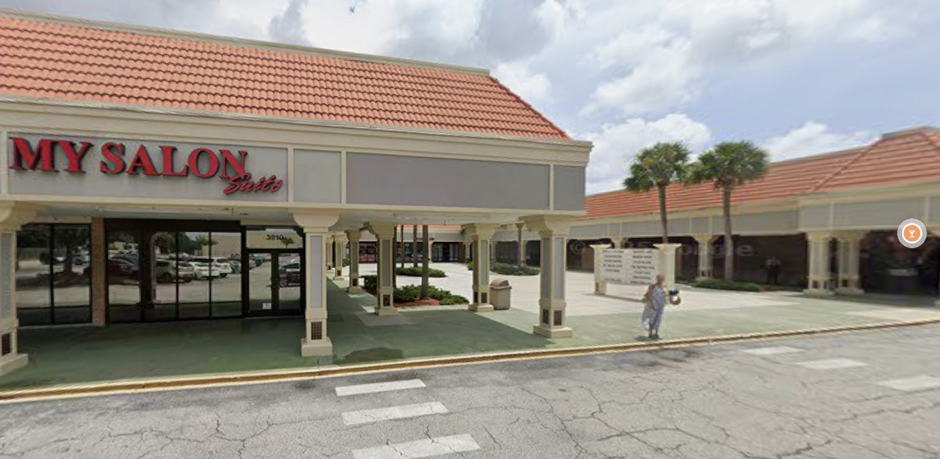
Development Plan
Current Property Issues
Center Parking is Under-Utilized
Limits walkability through all of shopping center and causes short dwell time at NW units
Facades & Common Space are Outdated
Weakens visual appeal and limits potential tenant engagement to lease current vacancies
Buffalo Rise Development

Slide 15
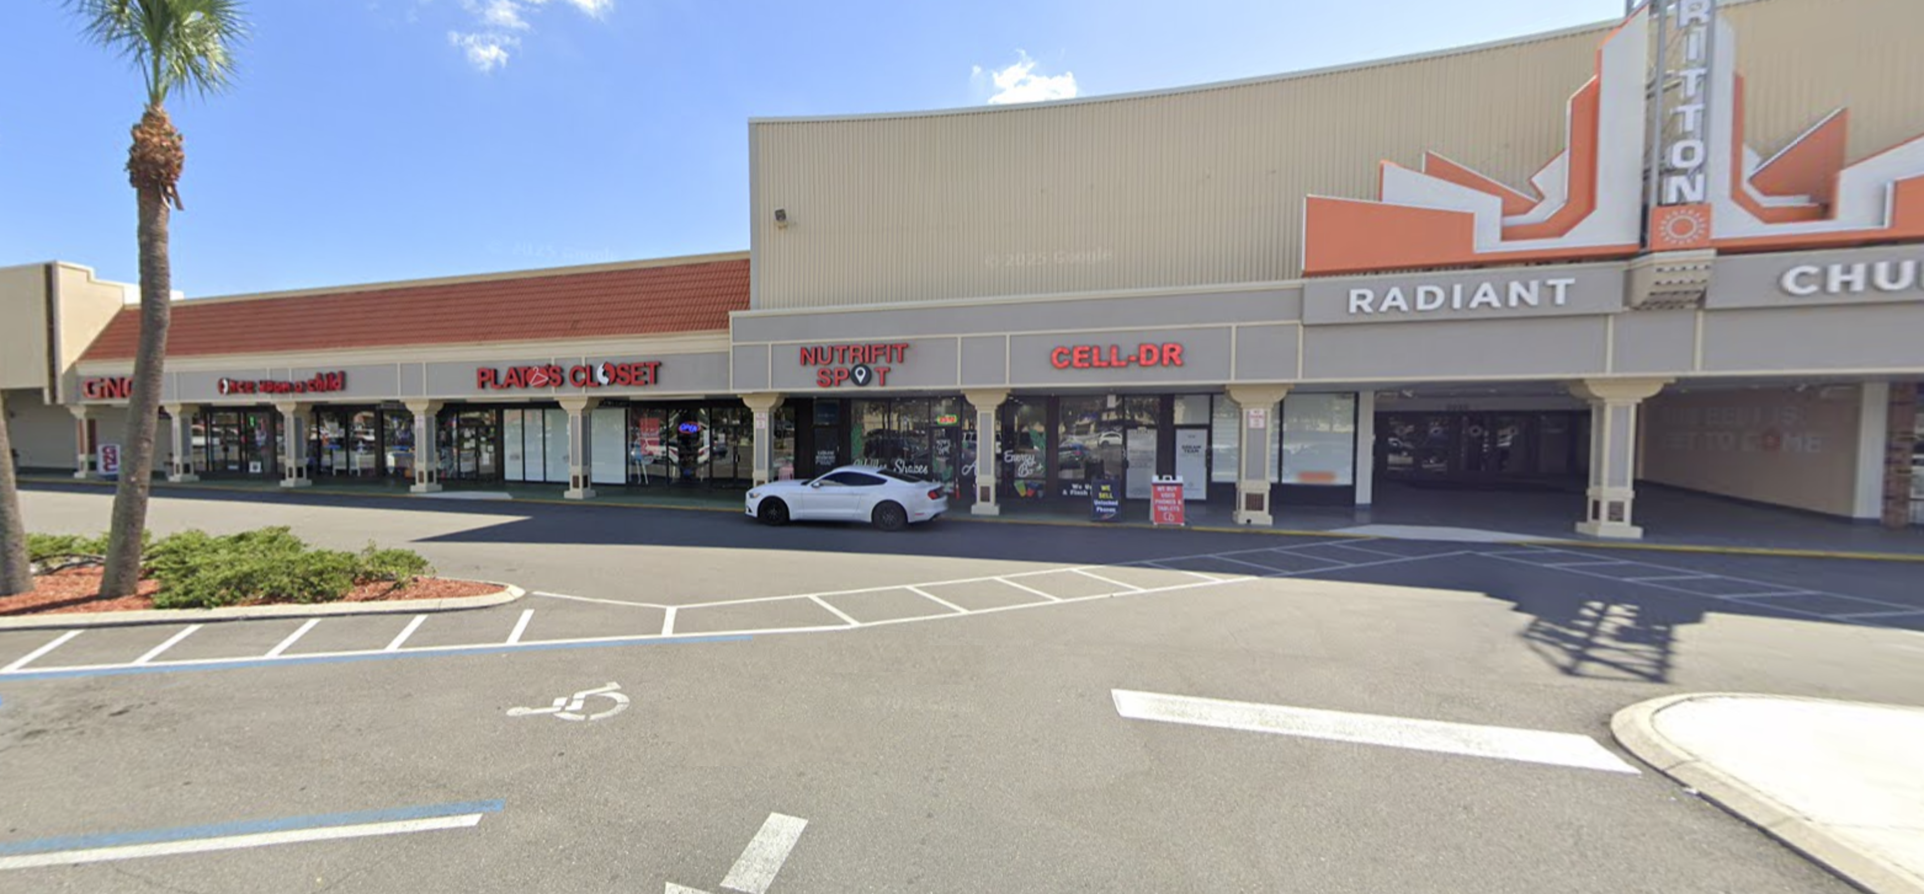
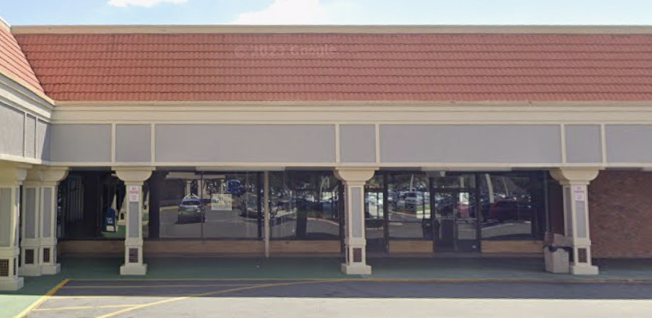
Development Plan
Room For Improvement
South End Shops are Cluttered
Mix of low-quality tenants and struggling walkability causes a less enjoyable space to shop
High Vacancy, Even in Large Spaces
25% vacancy has killed potential NOI capture, especially when comps have 100% occupancy
Buffalo Rise Development

Slide 16
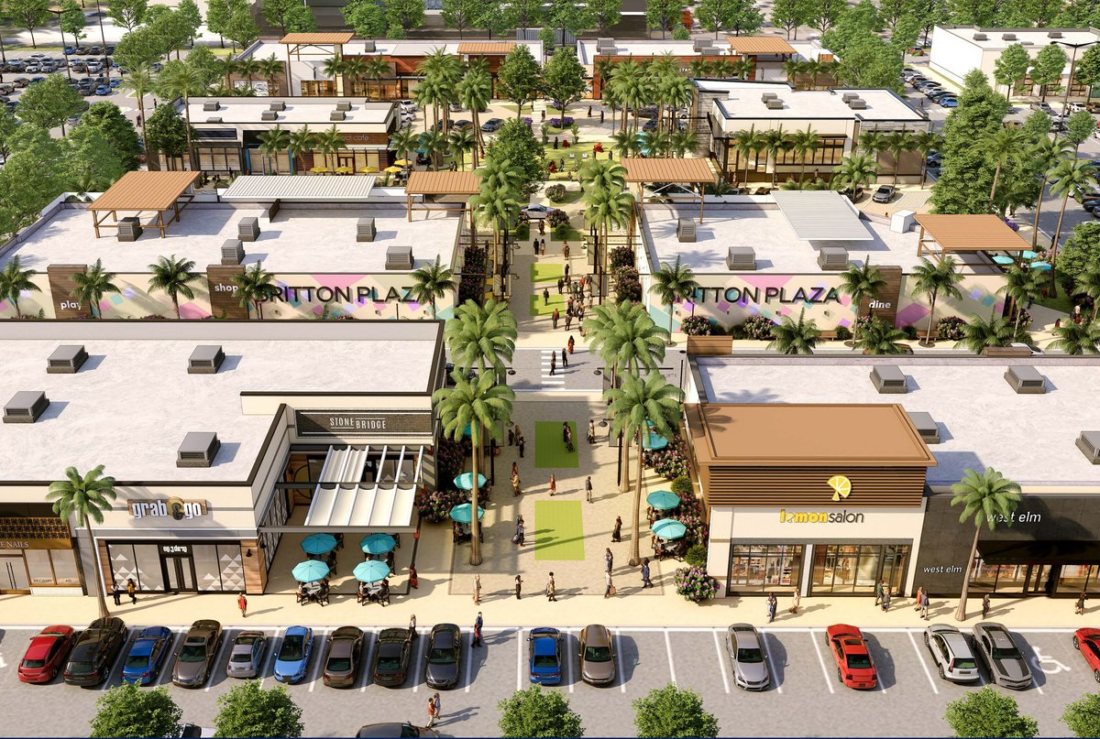

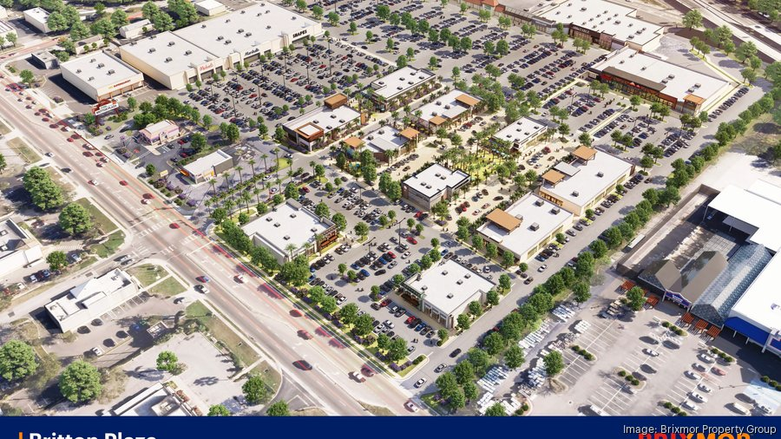


Development Plan
Brixmor’s Proposal
Mixed Community Opinions
“Change is always good.”
“If they’re trying to make everything all fancy… it doesn’t make sense. We already did that to Hyde Park, and it’s not fun anymore.”
The Buffalo Rise Solution
Embrace the “change” to lifestyle
Keep the affordability & key tenants
Sacrifice GLA for $PSF in new spaces
Buffalo Rise Development

Slide 17
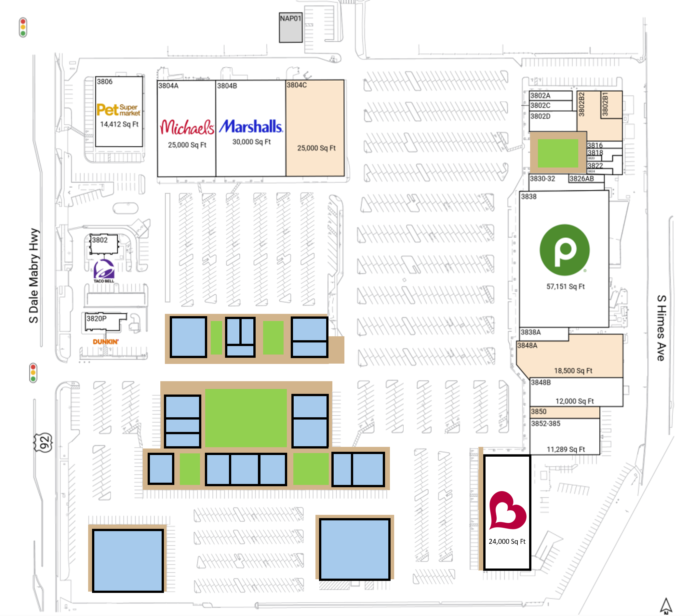
Development Plan
Proposed Lifestyle Conversion
Readjust Cluttered South Strip, Mostly Reusing Structures
Bridge the Gap From South End to the NW Tenants
Refreshed Green Space and Improved Walkability
Grass areas and patio space will allow outdoor dining, community events, and increase overall dwell times
Relocate Burlington to Smaller SE Space, Keep All Anchors
The lifestyle conversion will adjust parking. There will be no change in available spaces or traffic flow for anchors
Buffalo Rise Development

Slide 18
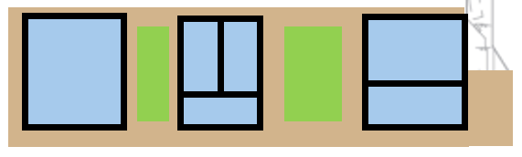
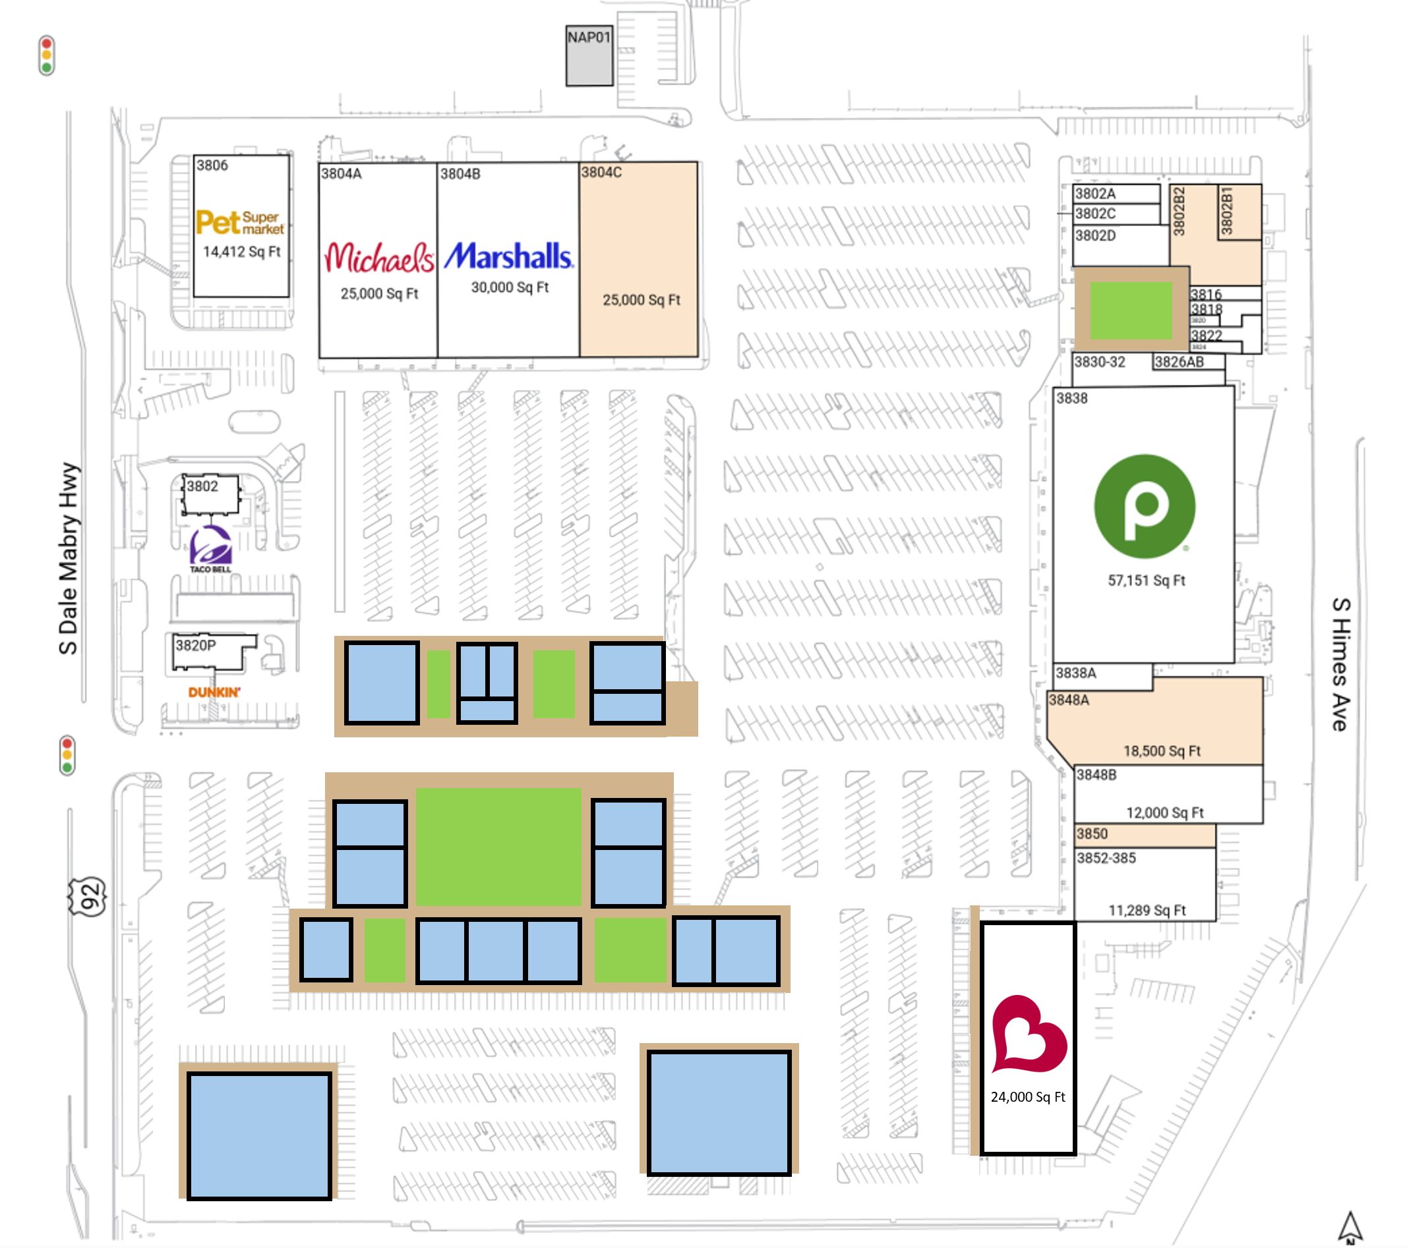












Development Plan
Site Breakdown and New Tenants
Possible Tenants
Walkable Shopping Area brings attention to the under-utilized middle portion of property
Buffalo Rise Development

Slide 19














Development Plan
Site Breakdown and New Tenants
Possible Tenants
Buffalo Rise Development

Slide 20


Development Plan
Site Breakdown and New Tenants
Possible Tenants
Relocation of parking here and west of new Burlington creates net zero change in space availability or car flow
Buffalo Rise Development

Slide 21







Development Plan
This Photo by Unknown Author is licensed under CC BY-NC-ND
Remaining Tenants and Vacancy
Possible Tenants
Possible Tenant
Buffalo Rise Development

Slide 22
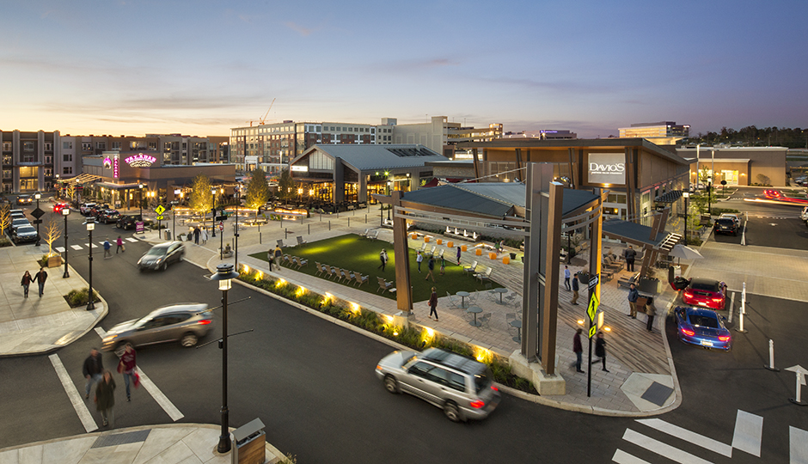
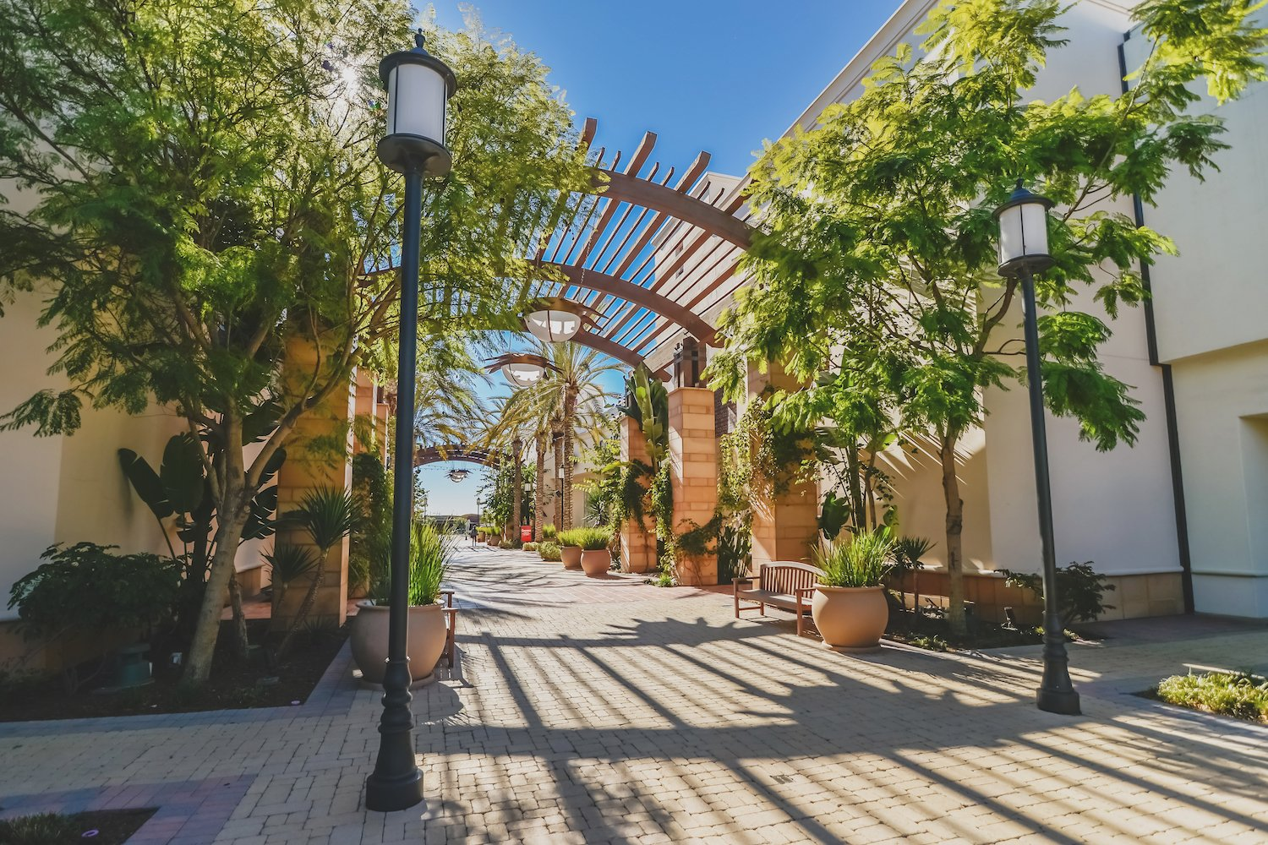
Development Plan
Community Space
Smaller greenspace used to create flow between stores & maximize overall dwell times
SW Redevelopment
Large central space used for community engagement through events
Buffalo Rise Development

Slide 23
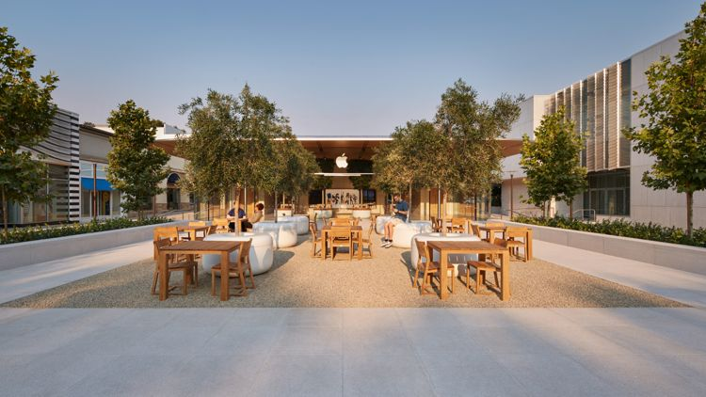
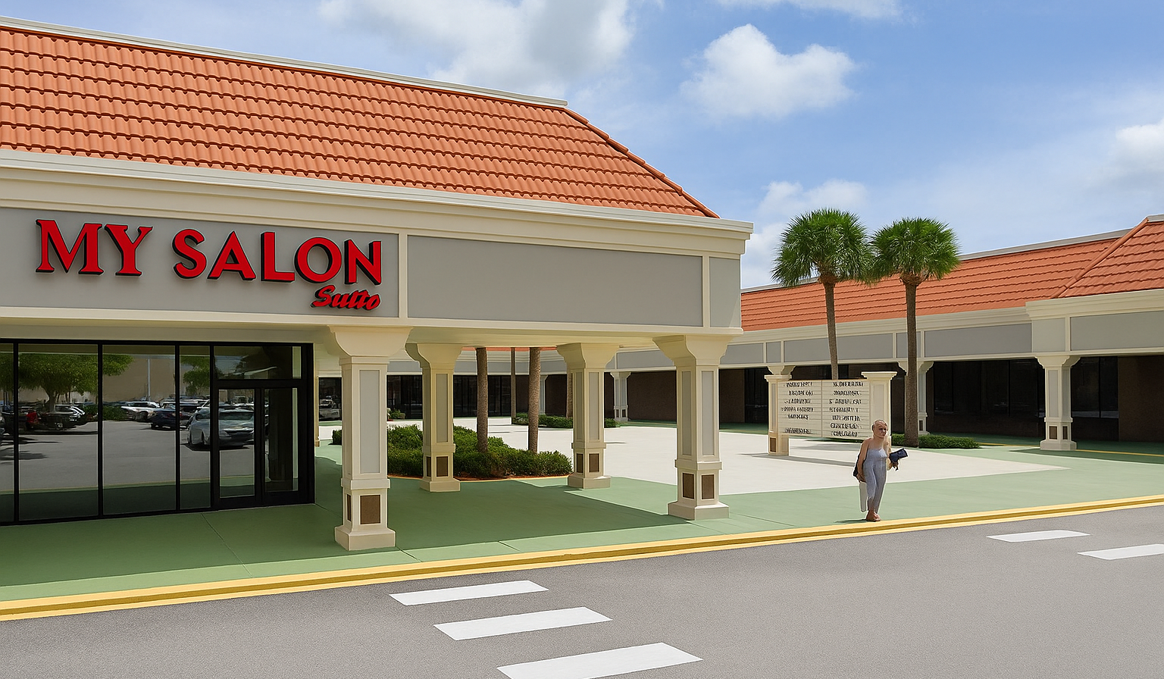
Development Plan
Community Space
Full Façade Refresh For All Existing Units
Simple courtyard refresh to increase visual appeal
NE Façade Refresh
Buffalo Rise Development

Slide 24
Development Plan
Project Timeline
Dec 2025
Mar 2026
Apr 2026
May 2026
Dec 2026
Jan 2027
Aug 2027
Jan 2028
Regulatory
Negotiate Leases
Phase 1
Build Center Units & Reno Unit 3916, Move Burlington & Greenberg Dental
Phase 2
Reconfigure NW Portion, Touch-Up Facades Through Whole Shopping Center
Phase 3
Construct New South Units & Renovate Others, Demolish the Remainder & Re-Circulate Parking Flow/Re-Stripe spots
Stabilization
Complete Lease Up & Stabilize
Buffalo Rise Development

Slide 25
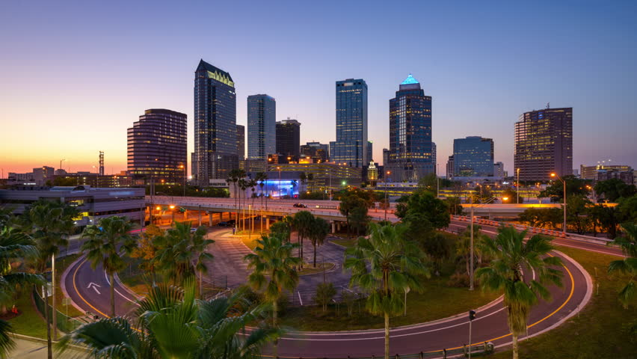
Financial Analysis
Buffalo Rise Development

Slide 26



Financial Analysis
Project Overview
Proposed Project:
Capital Stack:
Construction Loan:
$35,328,567
(65.0%)
Hard Costs:
$42,965,725
Soft Costs:
$6,444,859
Reserves:
$4,941,058
Brixmor Equity:
$19,023,075
(35.0%)
TDC: $54,351,642
Buffalo Rise Development

Slide 27
Financial Analysis
Debt Recommendation
To take on minimal risk, we recommend permanent debt sizing on a 1.25x minimum DSCR
Refi out of construction loan provides ~$8.7 million in additional equity
Buffalo Rise Development

Slide 28
Financial Analysis
New Tenant Rent Roll Analysis
NEW TENANTS PSF SF
Jared $29 6,000
The Vitamin Shoppe $29 2,000
Best Buy $32 18,500
Pop Up Shop $28 2,000
Club Pilates $30 2,000
Lilly’s Sweet Treats $29 3,500
Crumbl Cookie $32 2,500
Aerie $31 4,500
American Eagle $31 6,500
Smoothie King $31 4,500
Bath & Body Works $32 4,300
Alo $33 3,500
Verizon $34 4,000
Warby Parker $33 3,500
Tommy Bahama $28 4,000
Famous Footwear $29 7,000
Adidas $34 19,000
UPS $35 2,466
Vineyard Vines $33 7,534
Auntie Anne’s $27 2,850
Ashley Furniture $29 25,000
Einstein Bro’s Bagels $33 6,500
EXISTING TENANTS PSF SF
Publix $5.25 57,151
Dollar Tree $9.50 19,000
Dunkin Donuts $23.53 2,903
Taco Bell $3.13 2,600
Michaels $12.25 25,000
Marshalls $10.00 30,000
Pet Supermarket $11.57 14,412
Burlington $7.00 24,000
Skin Science $15.88 2,750
Greensburg Dental $19.38 3,750
Britton Plaza Vision Center $21.71 1,840
H&R Block $20.17 2,000
My Salon Suite $16.21 3,940
Sunset Chiropractic $17.79 1,600
Tapper Pub $23.75 2,400
The Missing Piece $12.50 12,000
Conviva Care Centers $12.00 11,289
Net Change (SF): -101,715
Buffalo Rise Development

Slide 29
Financial Analysis
Pro Forma & Assumptions
Key Assumptions:
Rent Growth: 3.0%
Stab. Vacancy: 5.0%
OPEX Growth: 2.0%
Buffalo Rise Development

Slide 30
Financial Analysis
Return Analysis
NOI/Value Improvement:
15-Year Returns
IRR: 18.65%
MOIC: 5.58x
Debt Yield: 10.25%
This repositioning project provides long-term value for Brixmor while still positively engaging the community
Current NOI:
$2,566,164
Current Value:
$39,479,446 (6.5% Cap)
Stabilized NOI:
$4,690,879 (+83%)
Long-Term (15yr) Value:
$104,943,890 (6.5% Cap)
Buffalo Rise Development

Slide 31
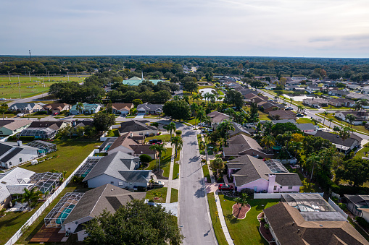
Risks & Mitigations
Buffalo Rise Development

Slide 32
Risks and Mitigations
1
Risk: Leasing New Tenants
Mitigation: We phased construction to allow a dynamic lease-up timeline through a 24-month period
High
3
2
Risk: Community Opposition
Mitigation: Retain key anchor tenants to preserve familiarity while adding community–oriented spaces
2
Severity
1
3
Risk: Construction Costs & Inflation
Low
Mitigation: A 10% construction reserve and 15% hard cost contingency were added to outweigh cost overruns
Low
Likelihood
High
Buffalo Rise Development

Slide 33



Final Recommendation
Britton Plaza
Britton Plaza will be developed into an open air lifestyle center, that will be catered to the wants and needs of the Tampa Community
Community
Listened to local community feedback to shape tenants and ensure the project’s design reflects neighborhood character.
Financials
IRR: 18.65%
MOIC: 5.58x
Current Value: $39,479,446 (6.5% Cap)
15 Year Value: $104,943,890 (6.5% Cap)
Britton Plaza
Buffalo Rise Development
Notes:
To close it out, we believe that the best course of action for britton plaza is to convert it to an open air shopping center. We have taken in all community feedback and have curated a tenant mix of upscale and affordable shopping with promising financials to support this decision. Thank you for your time and consideration.

Slide 34
Appendix
Buffalo Rise Development

Slide 35
Construction Draw Pt. 1
Buffalo Rise Development

Slide 36
Construction Draw Pt. 2
Buffalo Rise Development

Slide 37
Project Cost Breakdown
Buffalo Rise Development

Slide 38
Project Cost Breakdown
Buffalo Rise Development

