Slide 1

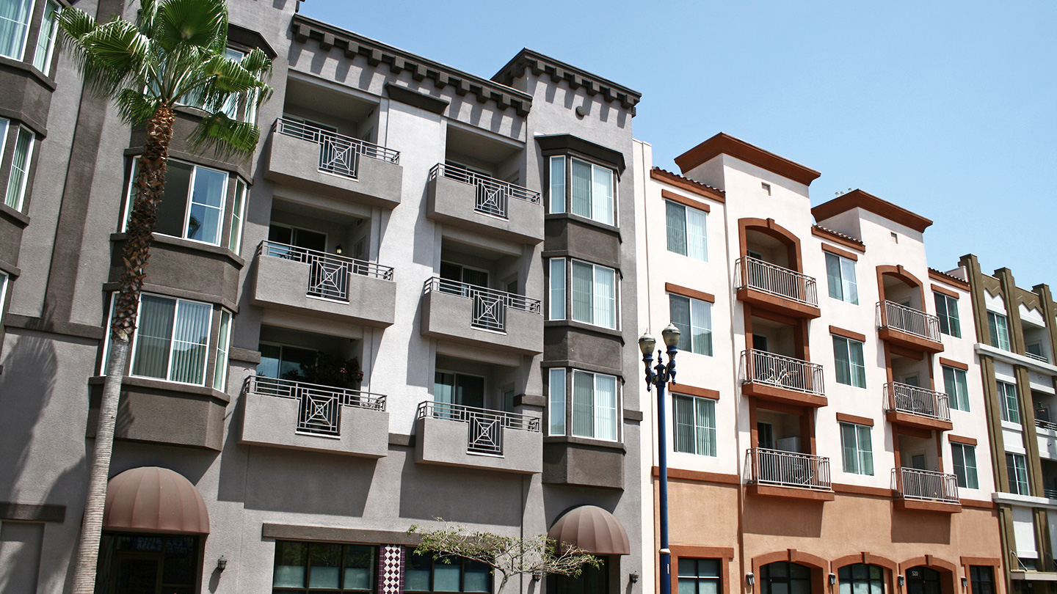


OSR News Report
“America’s Affordable Housing Crisis Is About to Get Worse” – CRE Daily
Article Overview:
The United States faces a worse affordable housing crisis, even with a 7.1 million-unit shortfall, due to Federal budget cuts and plans to slash HUD's workforce, end key housing programs, and limit nonprofit funding, which would put millions at risk.
Key Takeaways
The proposed federal cuts to the HUD’s assistance programs can make the already severe shortage of affordable housing worse.
Government support is crucial since there are only 35 affordable units per 100 low-income households.
Questions
How can cities such as Austin, TX and Las Vegas plan to address their severe affordable housing shortages?
What’s a significant factor that might contribute to the affordable housing crisis getting even worse than it is?
Why are private developers hesitant to build affordable housing, and what could potentially change that?
How does the rising construction cost affect the ability for developers or government to create more affordable housing within the United States?
Historical Context
The Great Depression was the first time the government intervened with public housing programs to address mass homelessness.
In the 1980s, the crisis worsened due to deep federal budget cuts to HUD and public housing programs.
Notes:
Complete News Report

