Slide 1

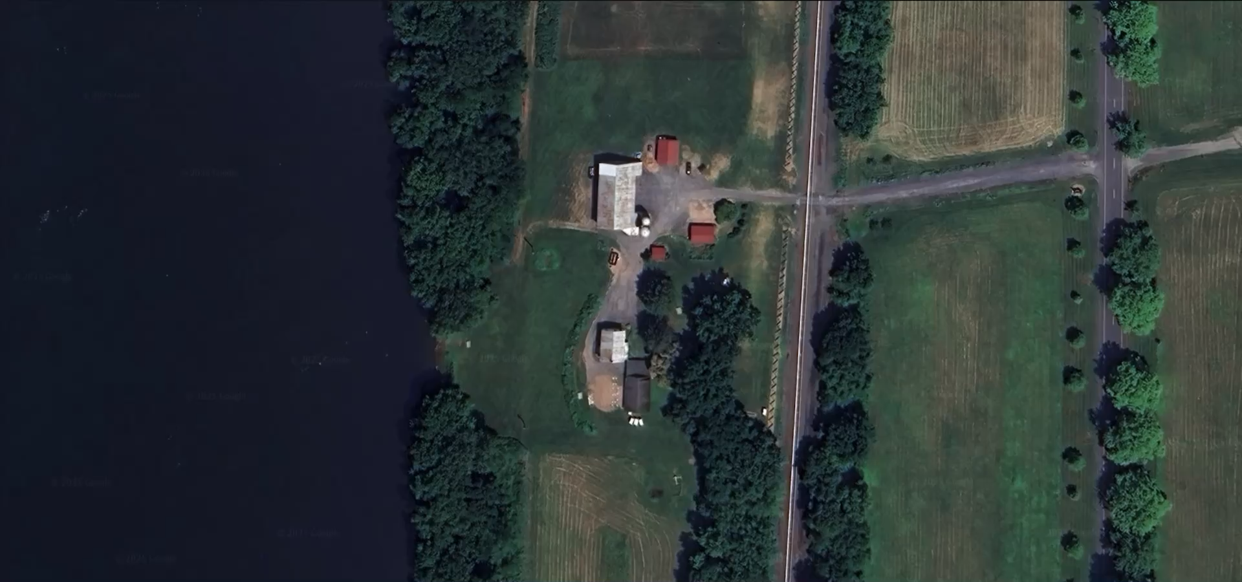
JLN Capital Partners

Slide 2
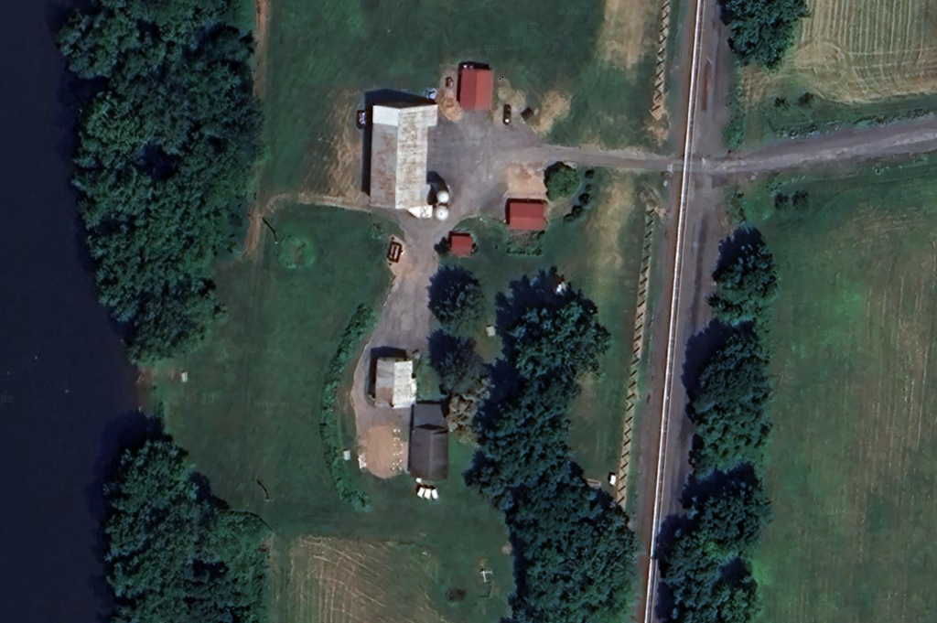
Executive Summary
Space Offering
Supplemental Parking
Site Size: 1.99 Acres
Retail: 10,500 SF
Tenants: 1 Tenant
Parking: 40 Stalls
Cul-De-Sac
Parking
Investment Plan
Redevelop the Fort Halifax parcel into a Fort Halifax themed restaurant with green space and a gift shop.
Restaurant
Turf
Project Returns
IRR: 31.62%
MOIC: 2.18x
Value at Disposition: $1,543,920
Stabilized COC: 7.76%
Fort Halifax Tavern

Slide 3
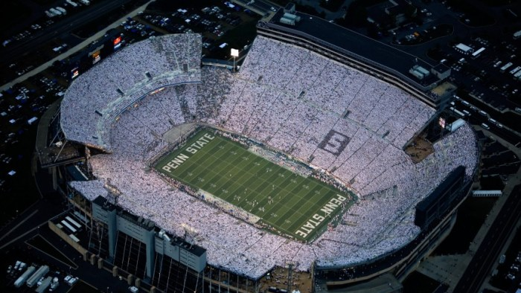
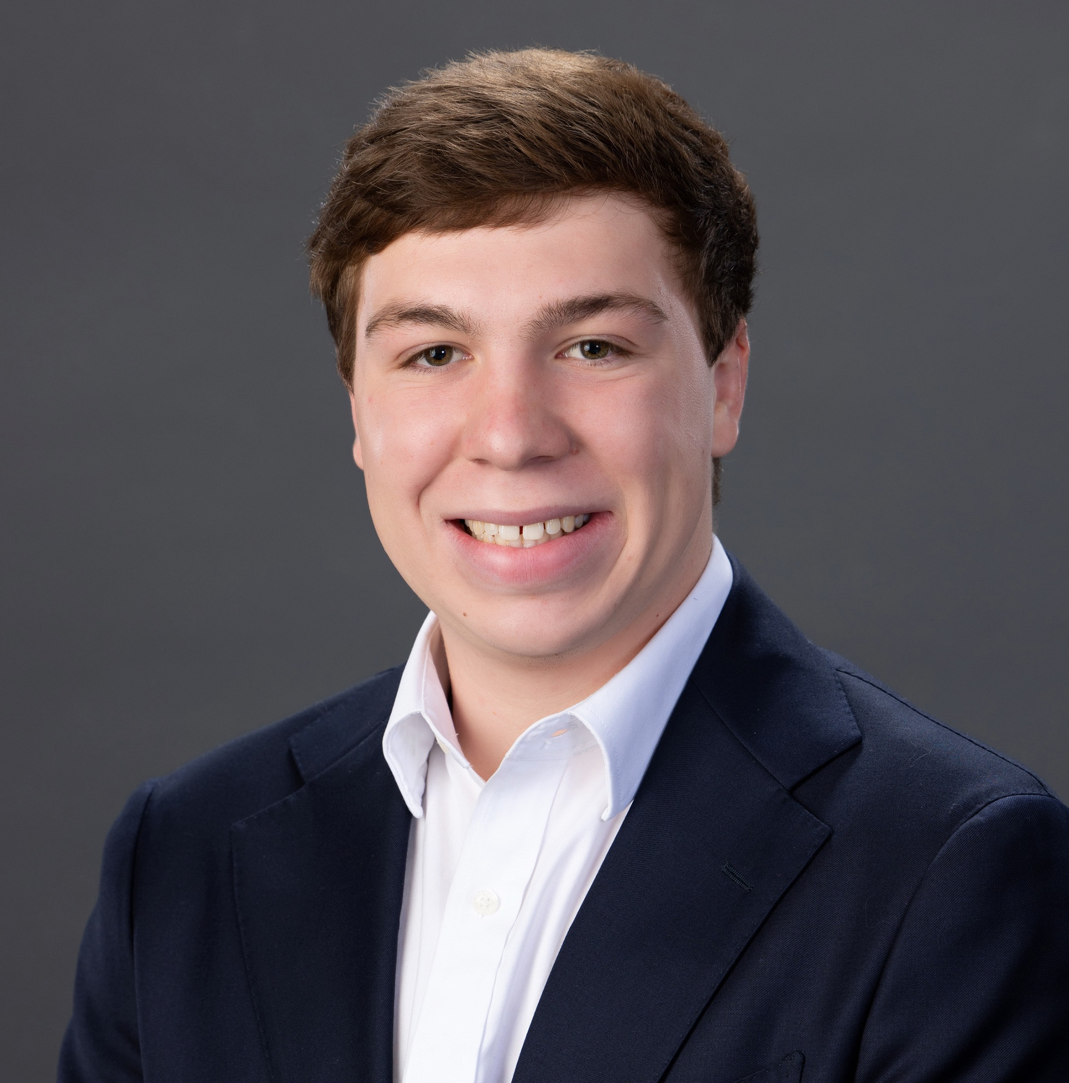
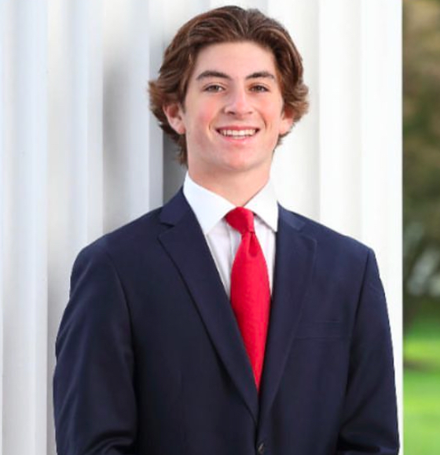
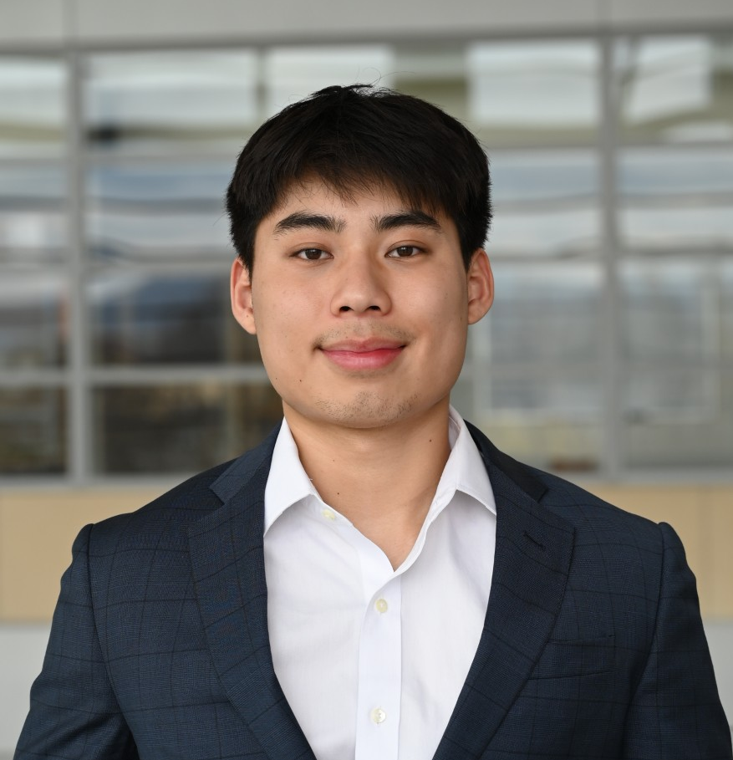
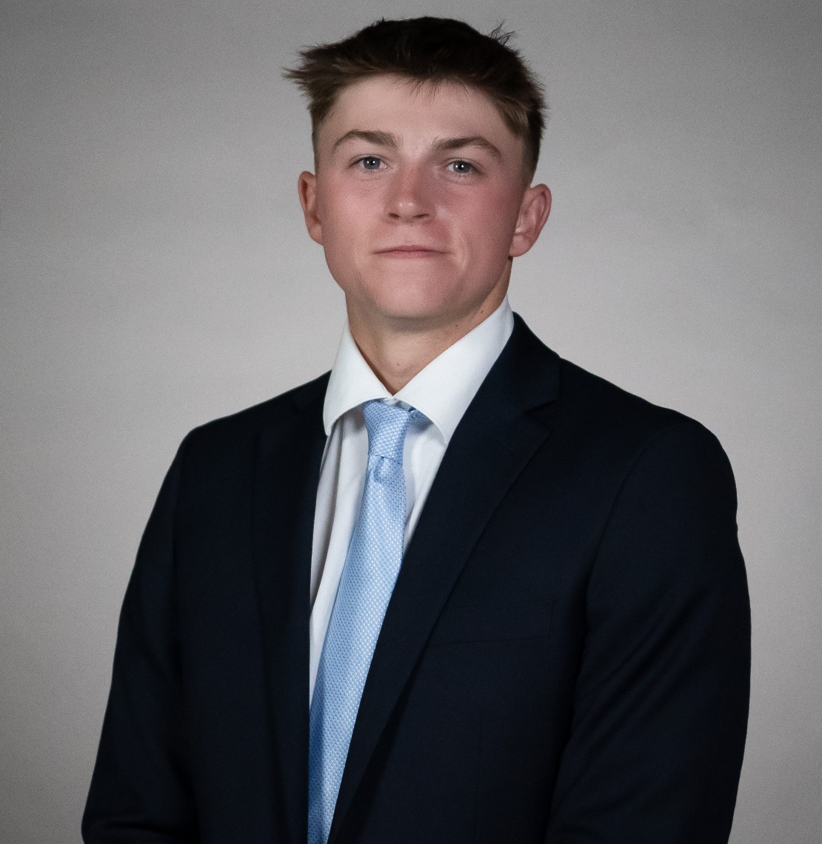

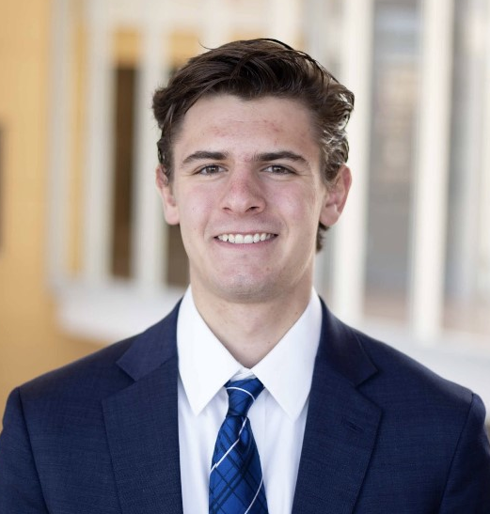

Meet the Team
Noam Pishoto
Associate
Class of 2028
Jake Goldstein
Associate
Class of 2027
Liam Buckley
Captain
Class of 2026
Dicky Lu
Senior Advisor
Class of 2025

Slide 4
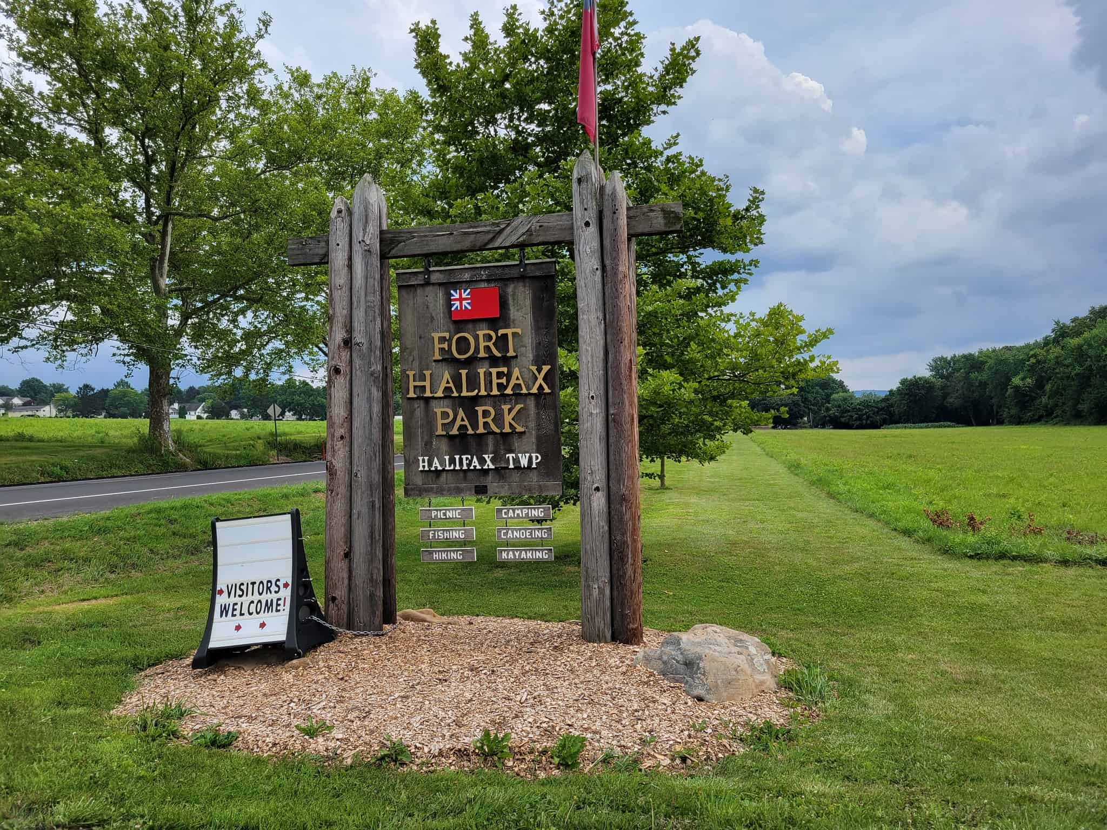

Agenda
Market Overview
Development Plan
Financials
Risk Analysis
Final Recommendation

Slide 5
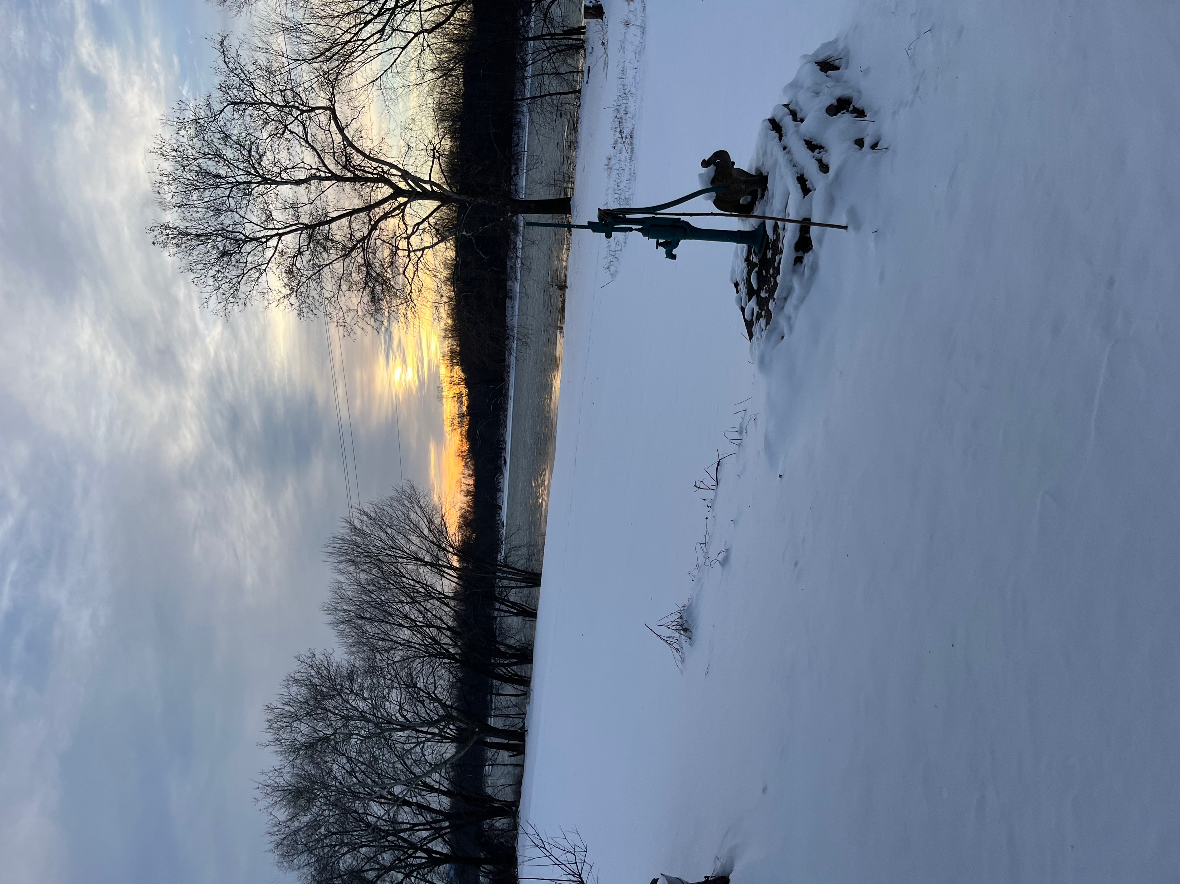
Market Overview

Slide 6

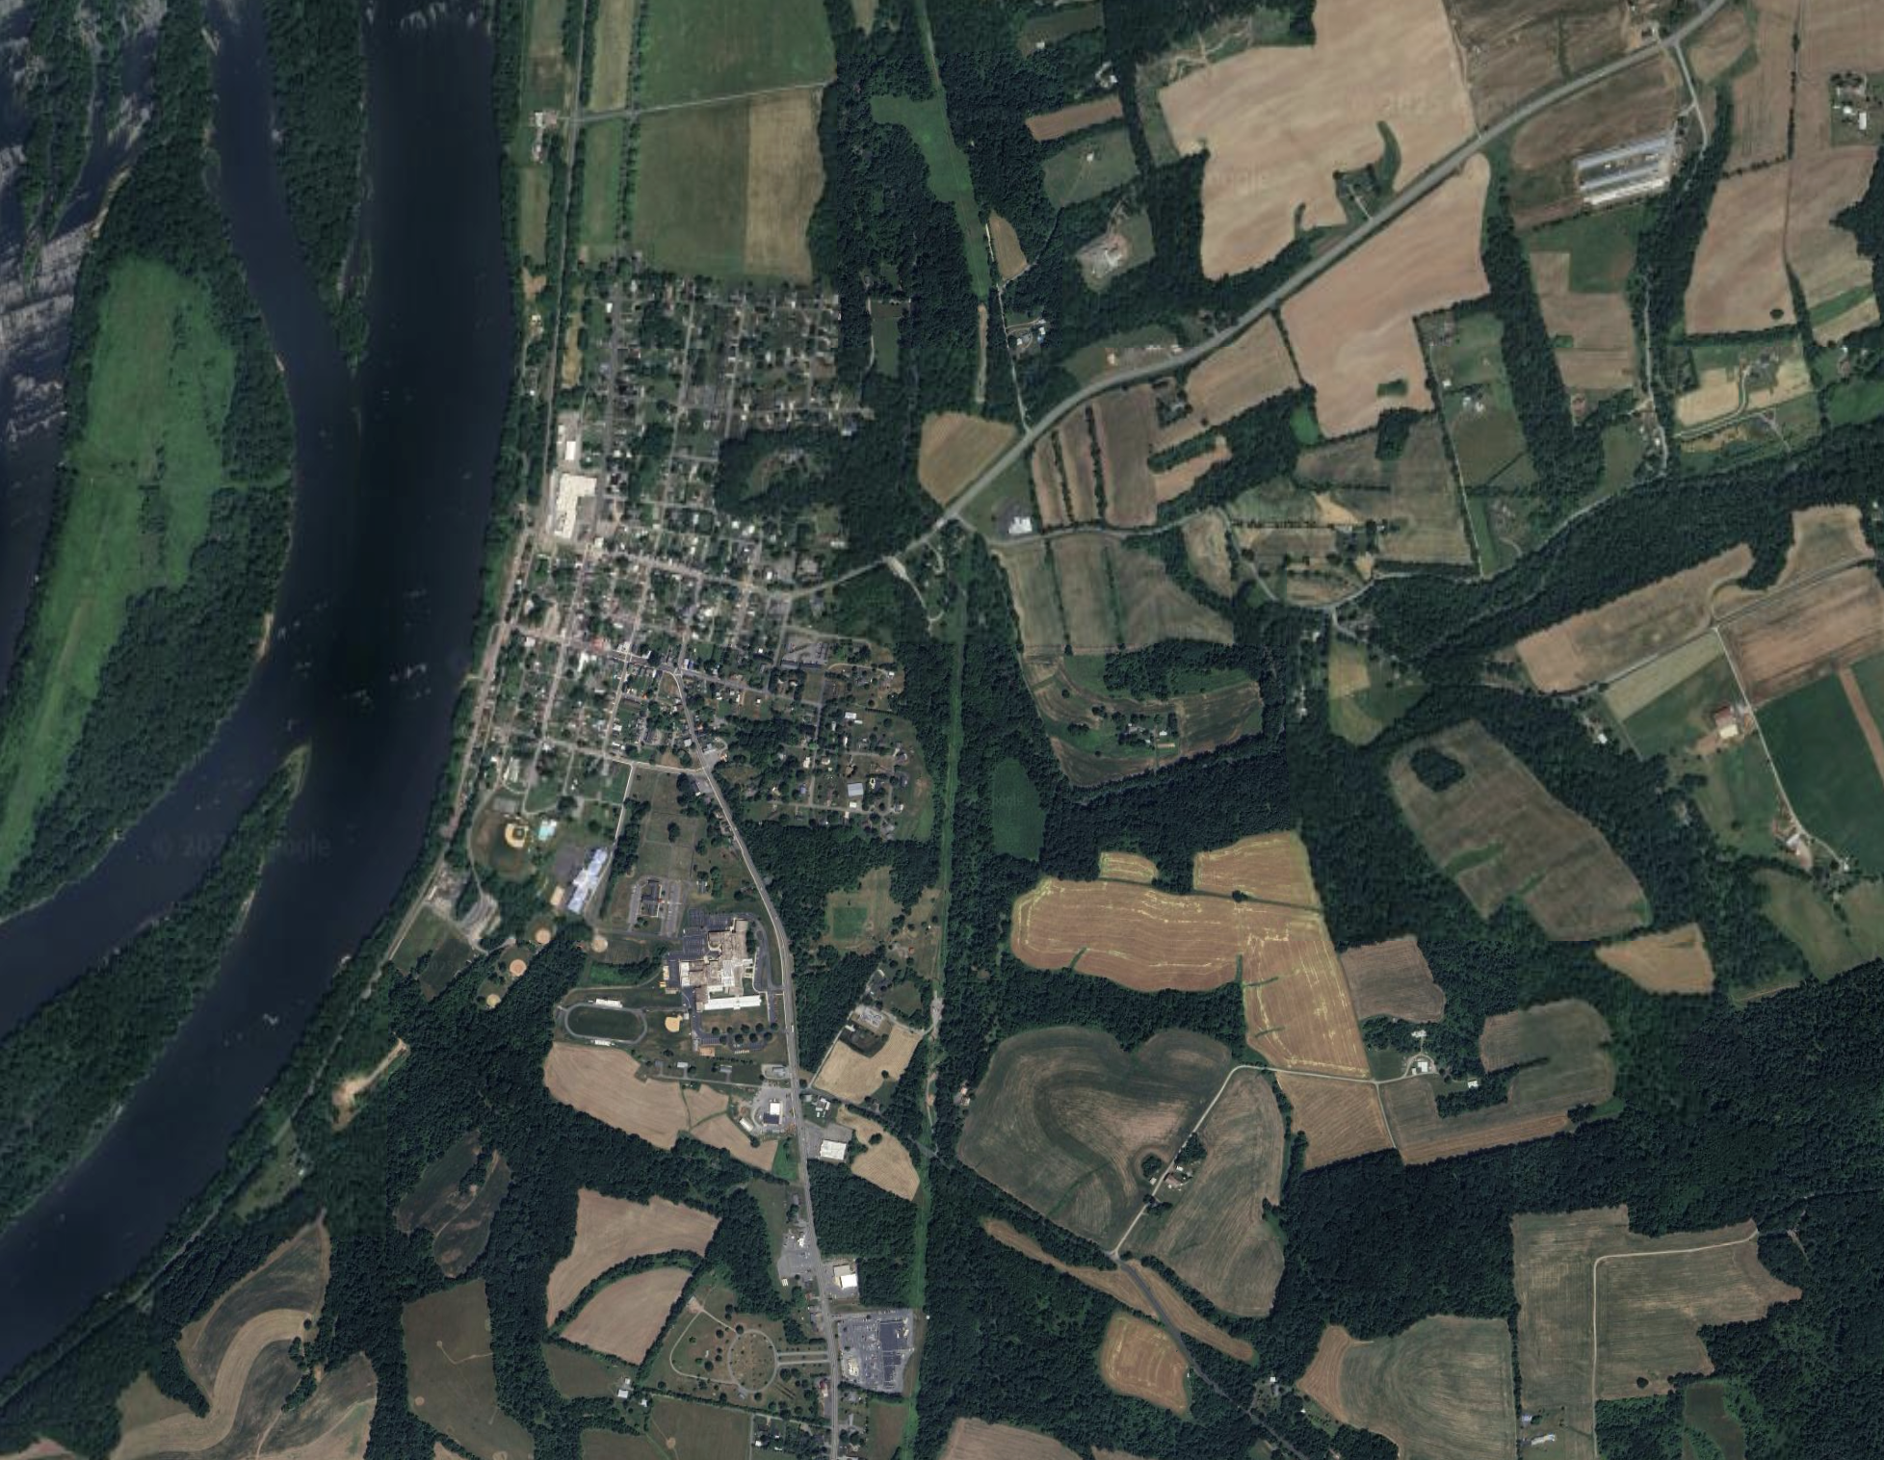


Points of Interest – Local Attractions
Halifax Area School District
Sports Fields
Giant Grocery Store Plaza
Halifax Area Authority- Deppen Park
Major Highways
Pa Rt 147
Pa 225
YMCA Child Development
*NOT PICTURED* Lake Tobias
Map Legend:
Market Overview
Development Plan
Financials
Risk Analysis
Final Recommendation

Slide 7
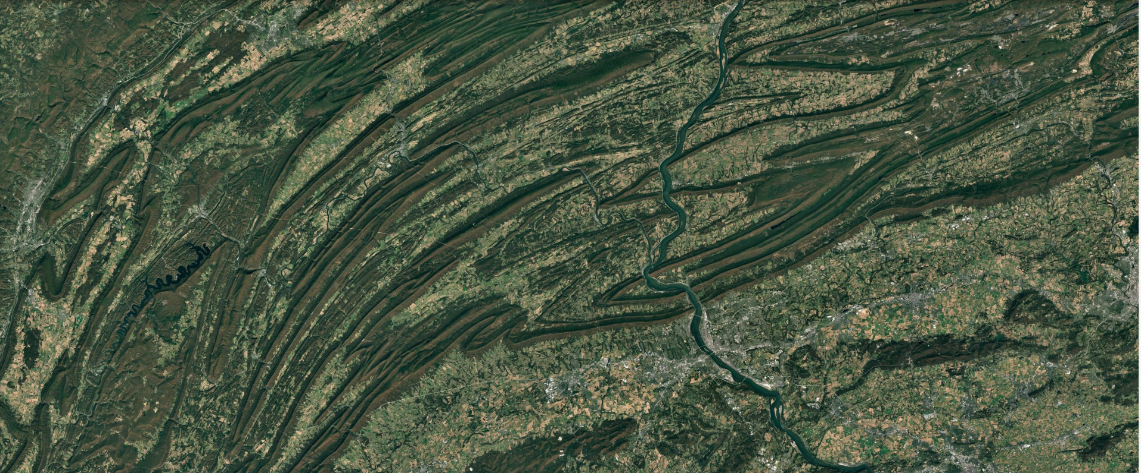
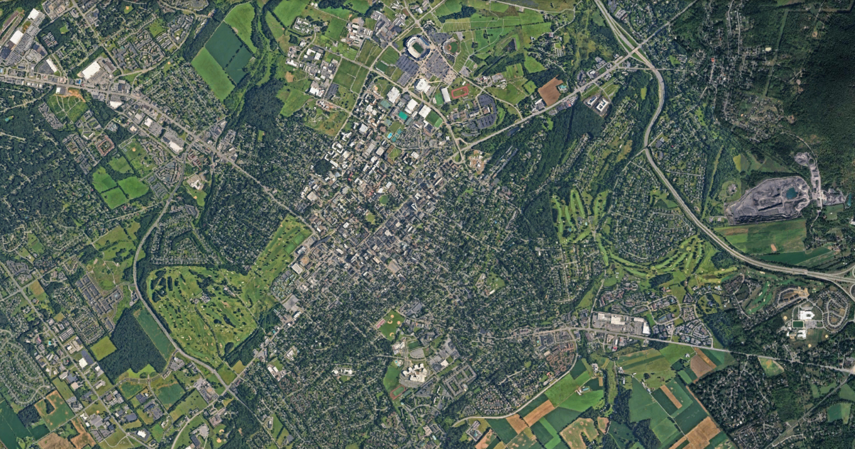





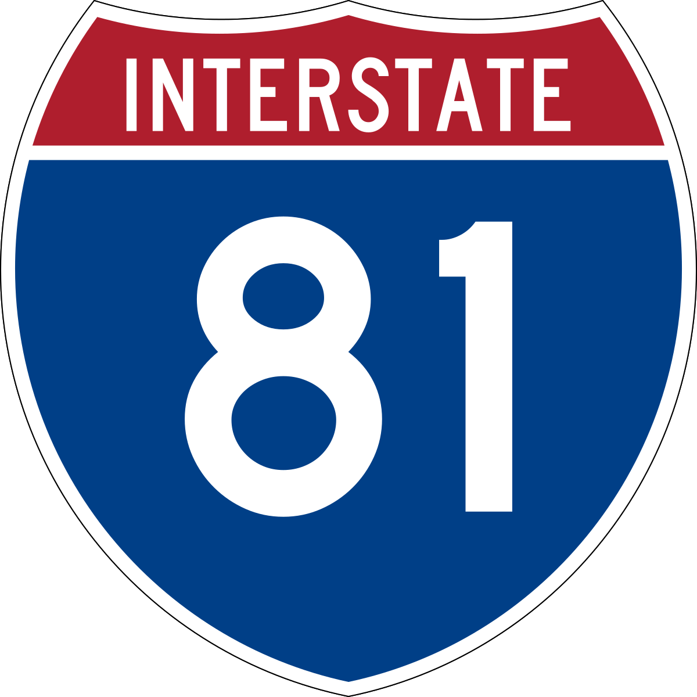
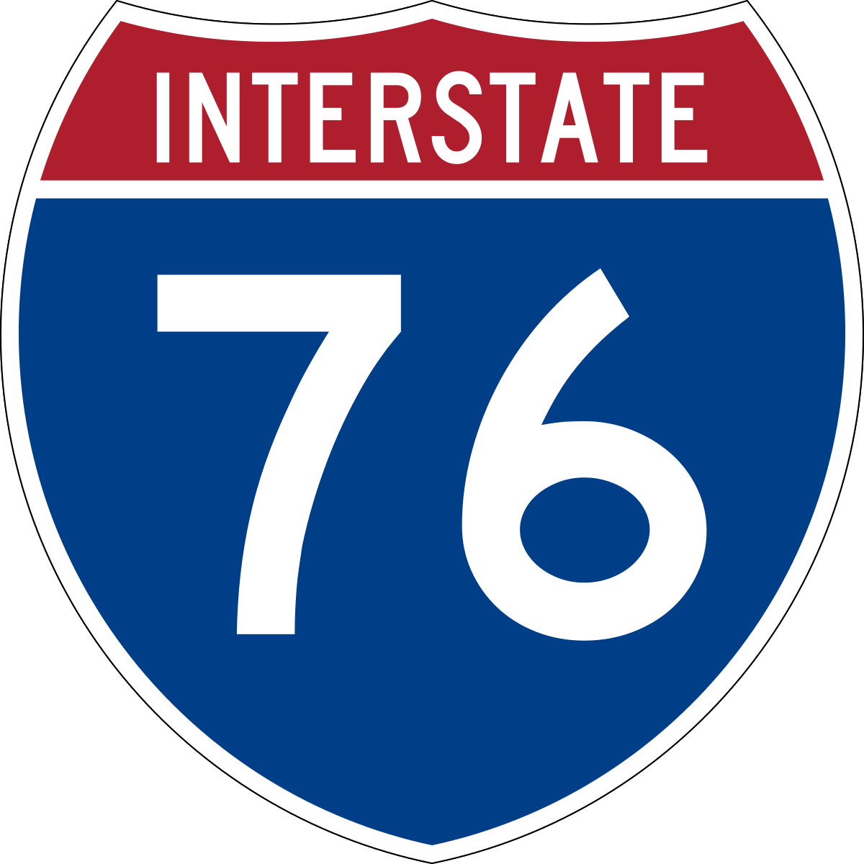
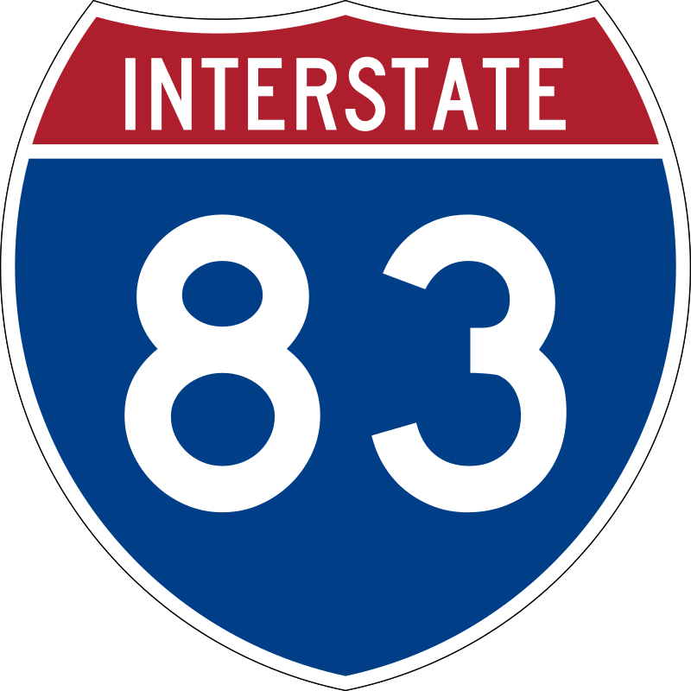
Points of Interest – Transportation
Map Legend:
State College
Penn’s Tavern
John Wright Store & Restaurant
Fort Halifax (Our Development)
Lake Tobias
Major Highways
  Rt. 15
  Rt. 22
  Rt. 209
  Rt. 322
  Rt. 522
  Interstate 76
  Interstate 81
  Interstate 83
Altoona
Halifax
Harrisburg
Hershey
Market Overview
Development Plan
Financials
Risk Analysis
Final Recommendation

Slide 8
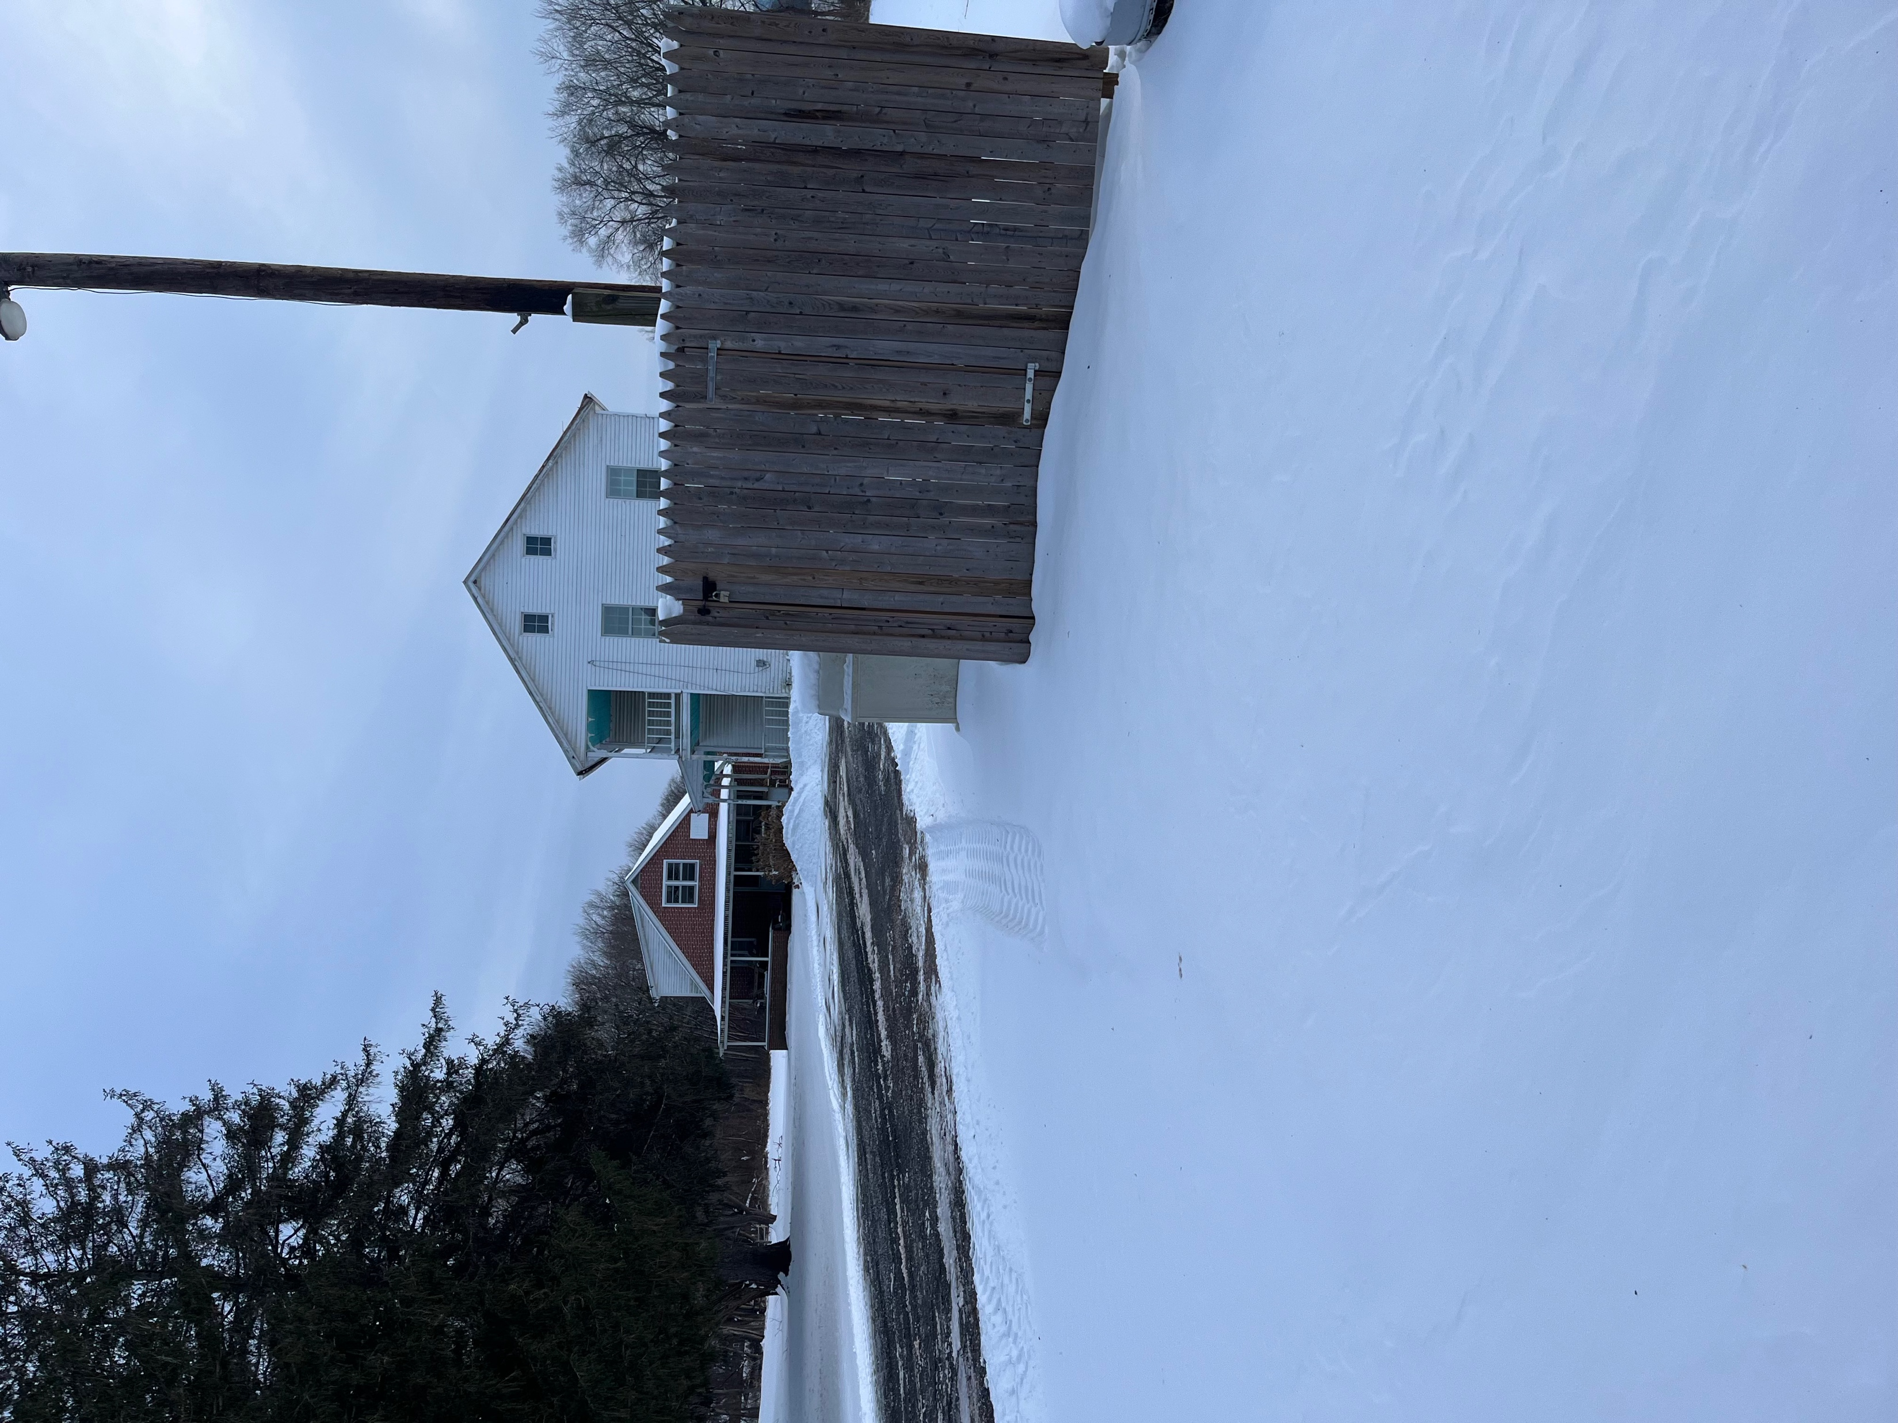
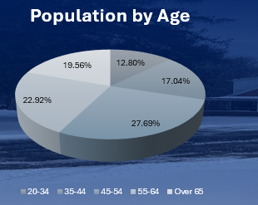
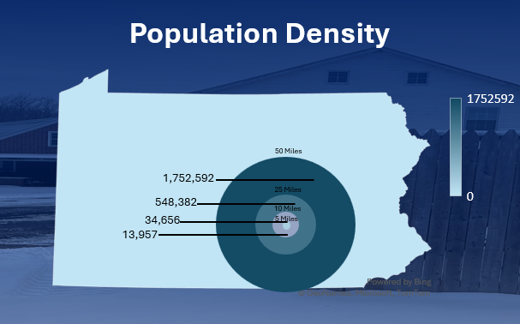

Neighborhood Overview
Median Age:
47.8
Population:
3,309
Median Home Price:
$273,500
Median Family Income:
$76,845
Lake Tobias: 240,000 Visitors Annually
Fort Halifax: 18,000 Visitors Annually
Market Overview
Development Plan
Financials
Risk Analysis
Final Recommendation

Slide 9
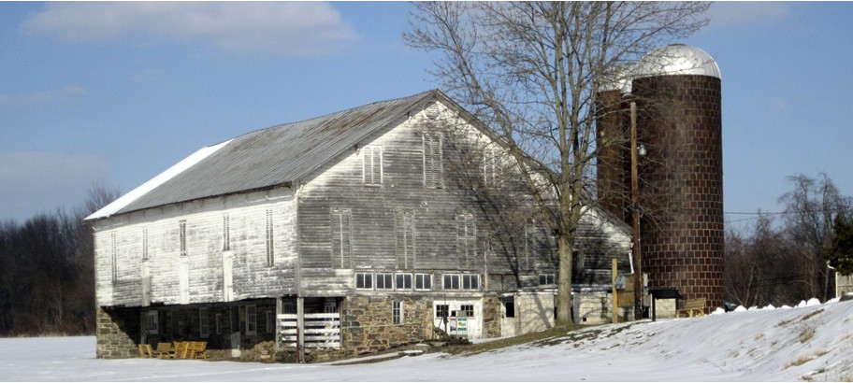
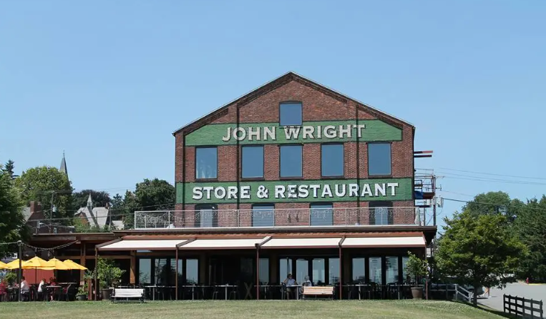
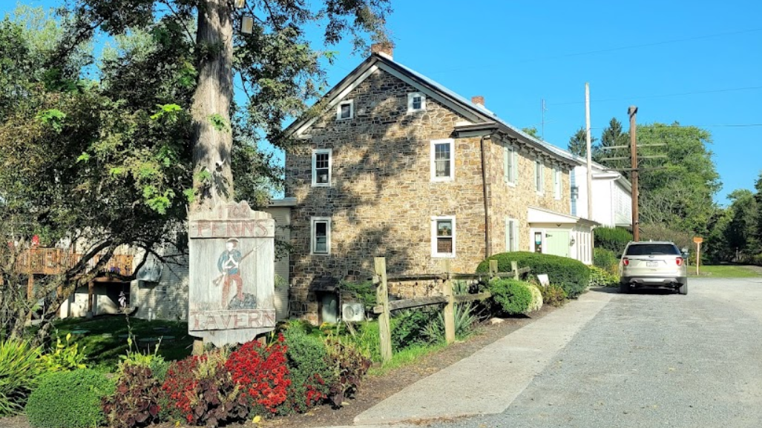
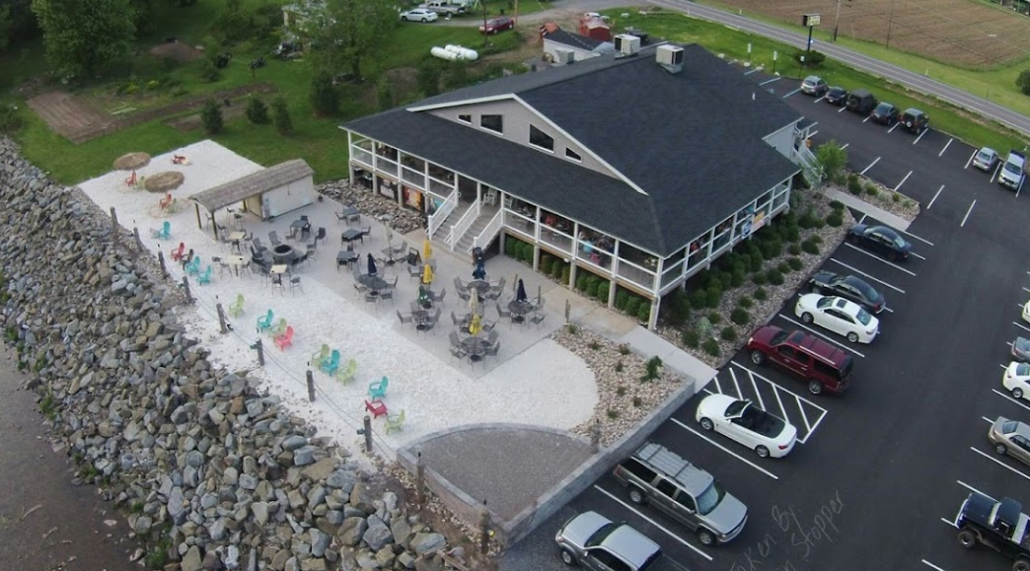
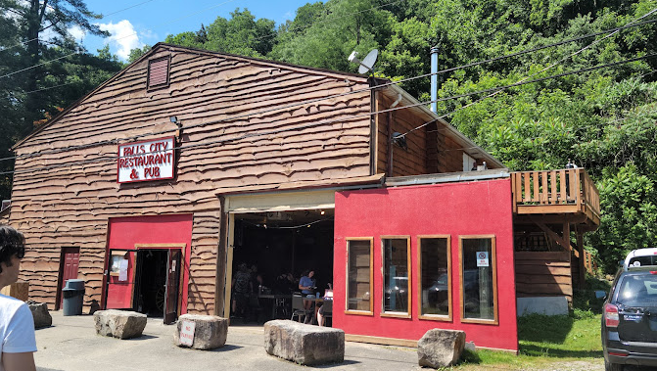


Comparisons
John Wright
Penn's Tavern
Pier 87
Falls City Pub
234 N Front St, Wrightsville, PA
SF: 5,800
Year Established: 1976
Avg. Home Price: $277,000
$/SF: 20.00
113 River Rd, PA-147, Sunbury, PA
SF: 4,500
Year Established: 1791
Avg. Home Price: $159,000
$/SF: 12.00
5647 PA-87, Williamsport, PA
SF: 6,700
Year Established: 2015
Avg. Home Value: $200,000
$/SF: 15.00
112 Garrett St, Ohiopyle, PA
SF: 3,500
Year Established: 2011
Avg. Home Price: $380,00
$/SF: 27.00
4.4 2,304 Reviews
4.6 896 Reviews
4.6 1,676 Reviews
4.4 560 Reviews
Market Overview
Development Plan
Financials
Risk Analysis
Final Recommendation

Slide 10
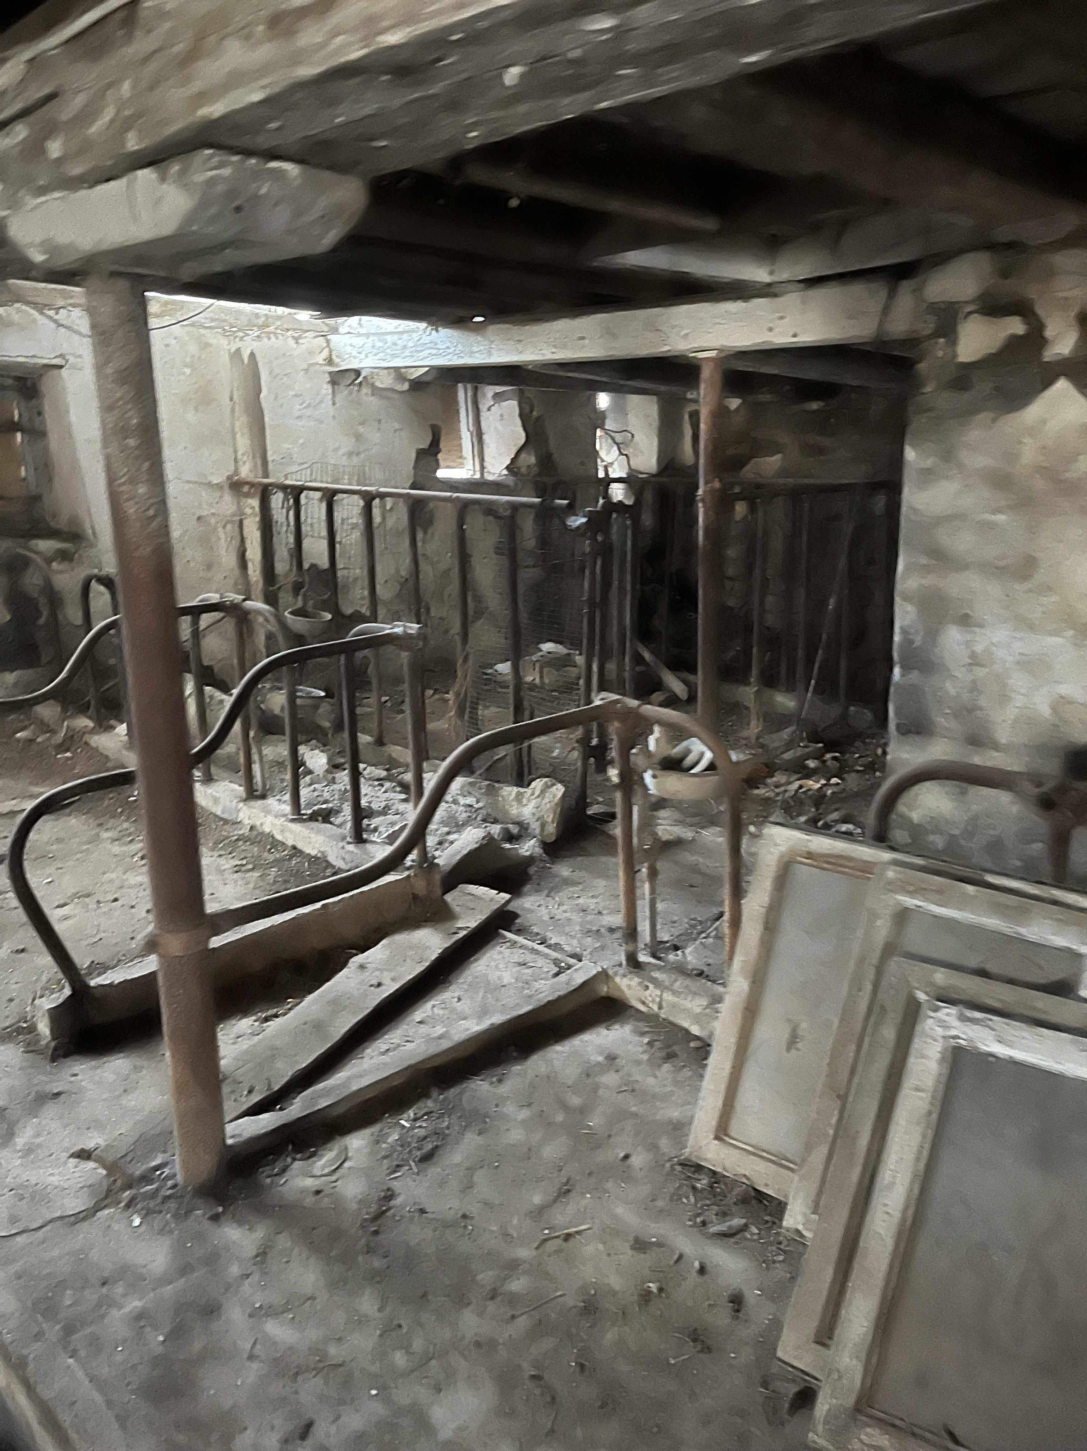
Development Plan

Slide 11

Site Overview
Supplemental Parking
Single Tenant Bar and Restaurant with Gift shop
Site Size: 1.99 Acres
Tenant: T.J. Rockwell's
Retail Space: 5,500 SF
Turf Space: 5,000 SF
Parking Stalls: 40
Cul-De-Sac
Parking
Restaurant
Turf
Market Overview
Development Plan
Financials
Risk Analysis
Final Recommendation

Slide 12

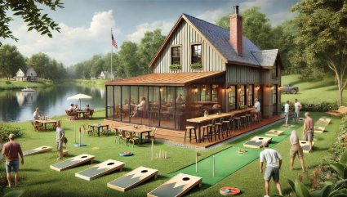
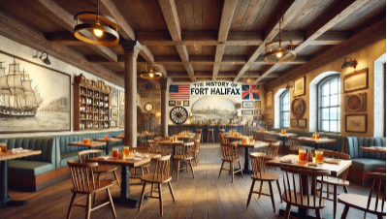
Experiential Dining/Historical Appeal
Cultural Significance: Attracts history enthusiasts and educates visitors
Unique Atmosphere: Art installations or sculptures to enhance ambience
Tourism Boost: Proximity to a historical site can increase foot traffic
Scenic Views: Offers a relaxing atmosphere
Interactive Experience: Yard games boost engagement and socializing
Versatile Appeal: Attracts diverse guests for various occasions
Market Overview
Development Plan
Financials
Risk Analysis
Final Recommendation

Slide 13
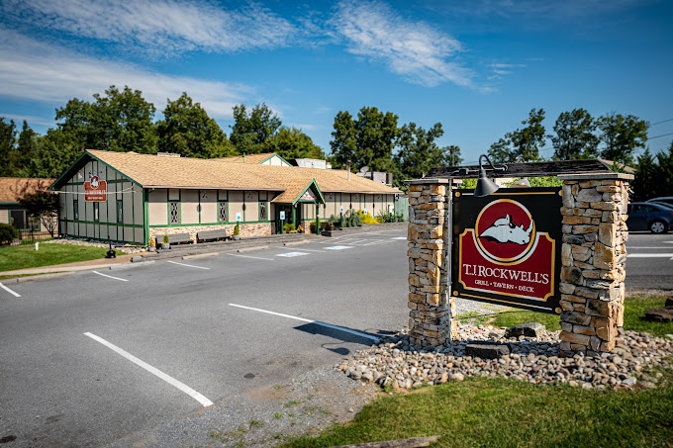
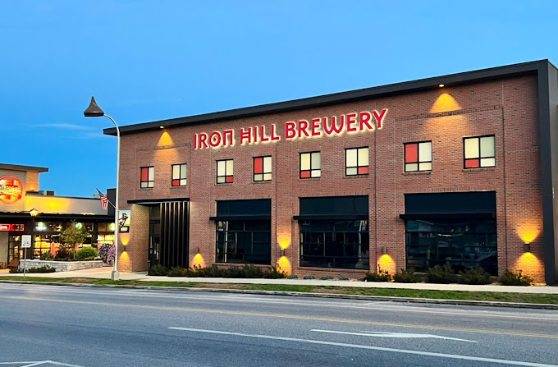
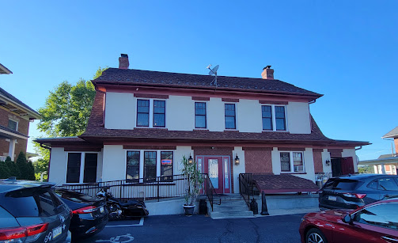
Tenant Analysis
T.J. Rockwell's
Babe's Grill House
Iron Hill Brewery
80 Mt Gretna Rd, Elizabethtown, PA
SF: 5,500
Location Count: 2
Years Established: 1998
Special Amenities:
Heated Outdoor Igloos
Patio Area
Live Entertainment
312 E Main St, Palmyra, PA
SF: 5,000
Location Count: 1
Year Established: 2013
Special Amenities:
Outdoor Seating
Entertainment Options
Private Dining Room
101 W Chocolate Ave, Hershey, PA
SF: 6,000
Location Count: 20
Year Established: 1996
Special Amenities:
Local Brewery
Private Event Spaces
Retail Beer
Market Overview
Development Plan
Financials
Risk Analysis
Final Recommendation
Market Overview
Development Plan
Financials
Risk Analysis
Final Recommendation

Slide 14

Fort Halifax
History of Fort Halifax
Built in 1756
Protected British settlers during French and Indian war
Giving Back to Halifax
Restaurant themed to celebrate the history of Fort Halifax
Using historical barn for restaurant construction
Free event space for the friends of fort Halifax and scout programs
Market Overview
Development Plan
Financials
Risk Analysis
Final Recommendation
Market Overview
Development Plan
Financials
Risk Analysis
Final Recommendation

Slide 15
Grants and Tax Abatements
Flood Mitigation Program
Sewage Facilities Program
Grant Overview:
Any construction for flood protection granted up to 5% of total construction costs ($57,758.25)
Grant Use:
Money will be used to construct protective measures against flooding of the Susquehanna river
Grant Overview:
Any costs associated with planning work under the Pennsylvania Sewage Facilities Act ($37,500)
Grant Use:
Pay for septic system and any other fees
Market Overview
Development Plan
Financials
Risk Analysis
Final Recommendation
Market Overview
Development Plan
Financials
Risk Analysis
Final Recommendation

Slide 16
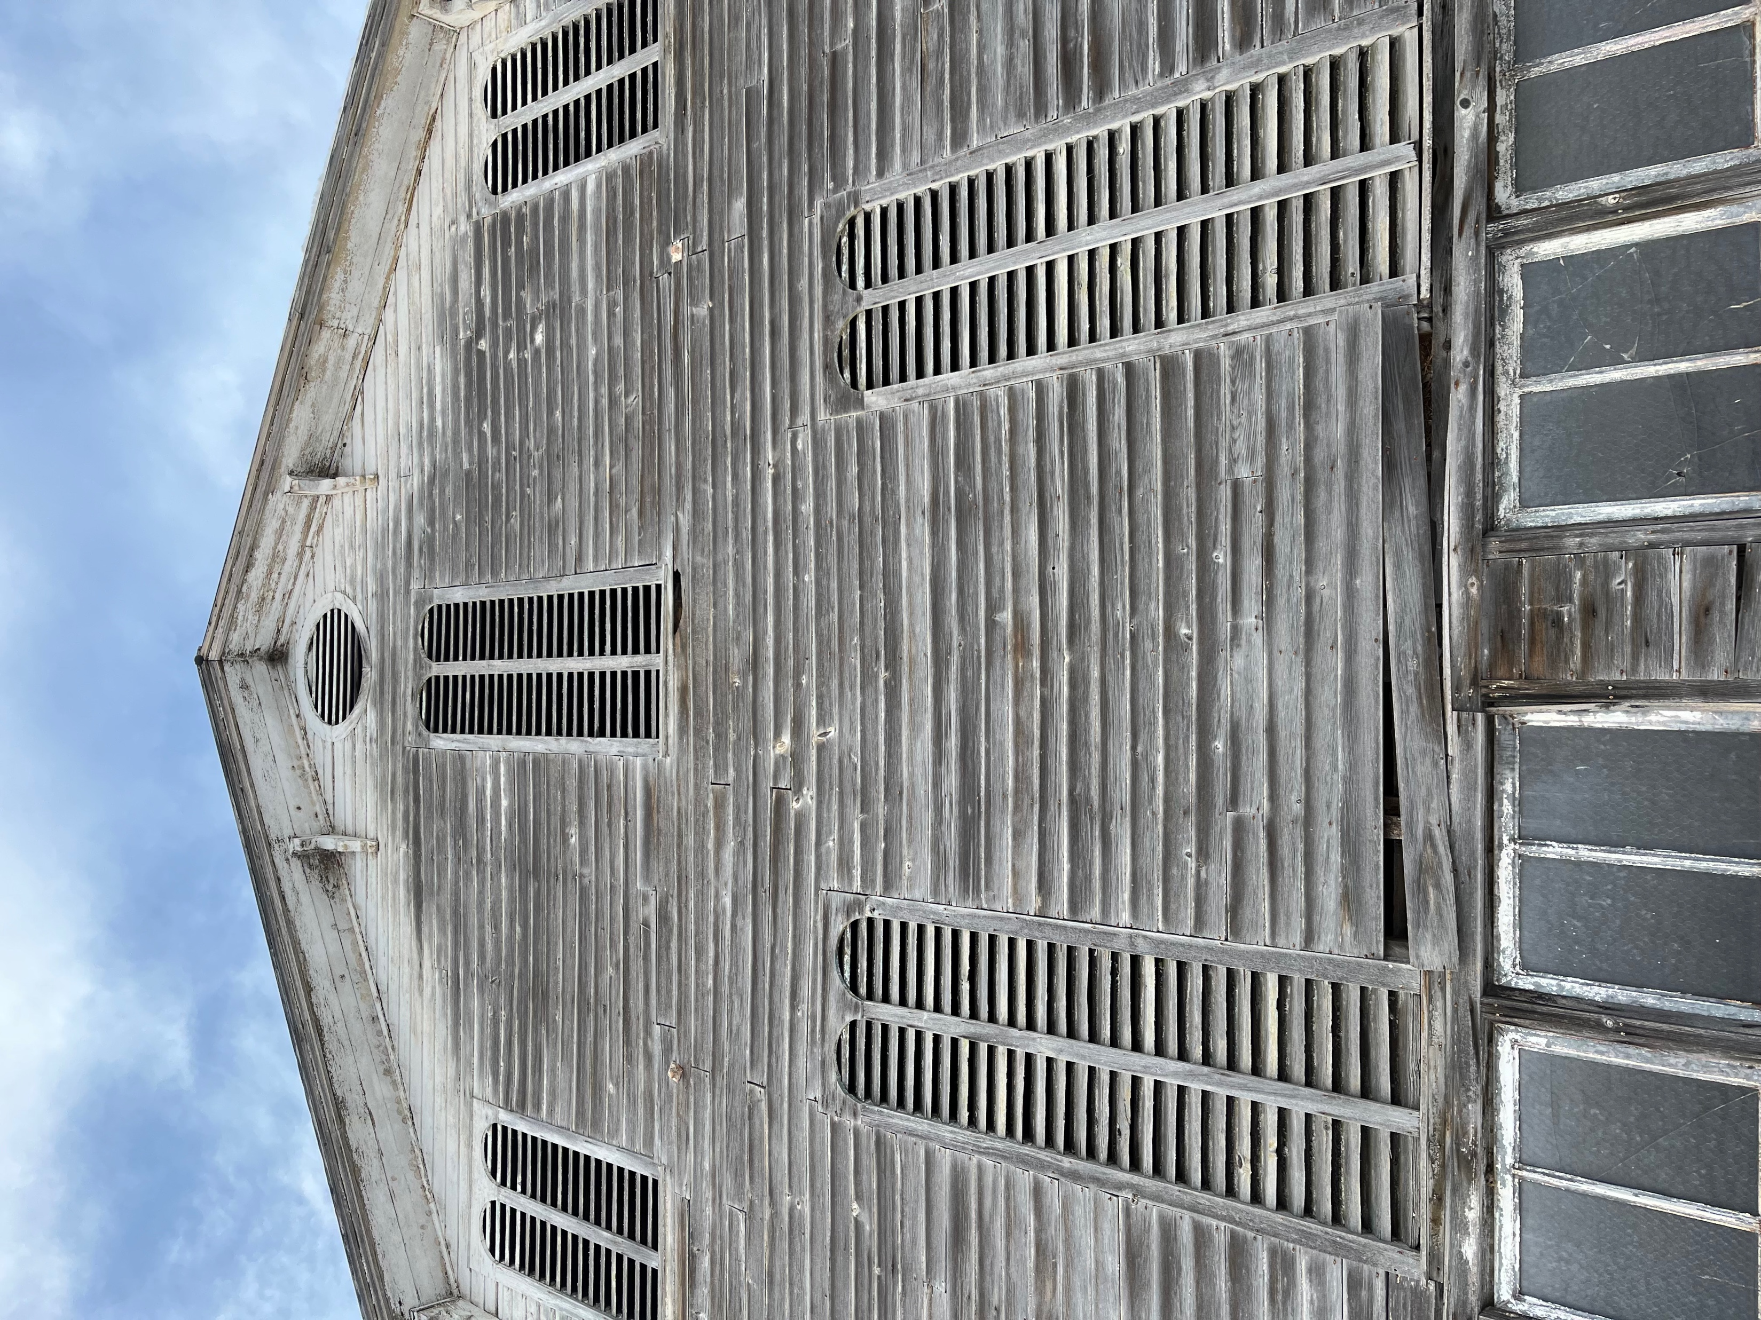
Financials

Slide 17
Financial Summary
Project Overview
Stabilized Data
Returns
Project Cost:
$1,106,785.88
Debt Yield:
12.68%
Levered IRR:
31.62%
Construction Period:
7 Months
DSCR:
1.51x
Unlevered IRR:
15.84%
Exit Cap Rate
8.30%
Yield on Cost:
10.80%
Market Overview
Development Plan
Financials
Risk Analysis
Final Recommendation
Financials
Risk Analysis
Final Recommendation

Slide 18
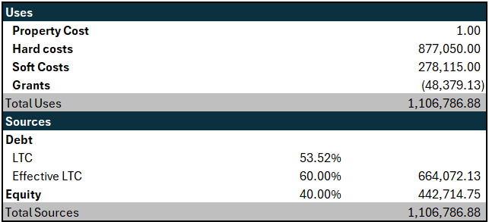
Sources & Uses
Capital Stack
Senior Debt
60.00%
40.00%
Equity
Market Overview
Financials
Risk Analysis
Final Recommendation
Market Overview
Development Plan
Development Plan
Financials
Risk Analysis
Final Recommendation

Slide 19
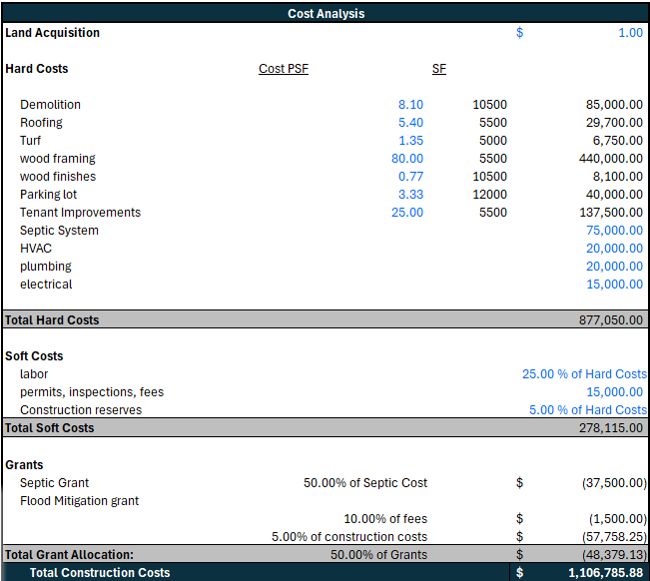
Construction Financing
Financing Details:
60.00% LTC
Interest: S+450
Loan Fees: 1.00%
7 Month Term
Refinance to Perm Financing after Construction
Market Overview
Financials
Risk Analysis
Final Recommendation
Market Overview
Development Plan
Development Plan
Financials
Risk Analysis
Final Recommendation

Slide 20
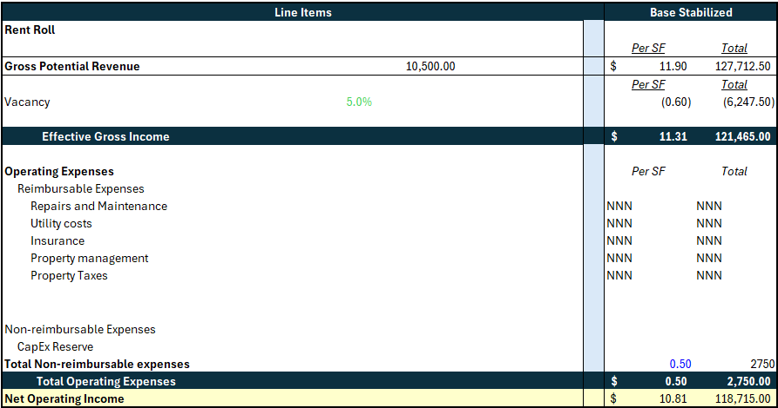
Stabilized Proforma
5.00% Vacancy
TI: $25 PSF
2.00% Rental CAGR
10.00% Management Fee
$0.50 PSF CapEx Reserve
Key Assumptions:
Market Overview
Financials
Risk Analysis
Final Recommendation
Market Overview
Development Plan
Development Plan
Financials
Risk Analysis
Final Recommendation

Slide 21
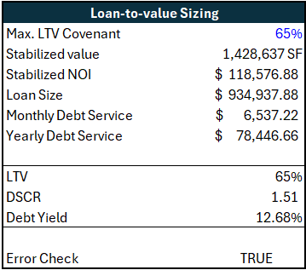
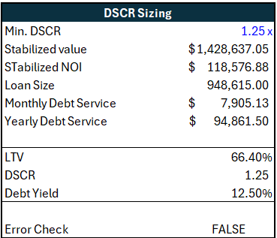
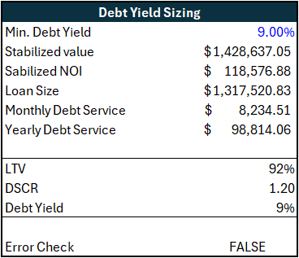
Permanent Debt Analysis
Loan Terms:
Effects of Refi Post-Construction:
Interest: 7.50%
Term: 10 Years
Amortization: 30 Years
Initial refinance will bring an additional $273,995.20 of equity into the deal
Market Overview
Financials
Risk Analysis
Final Recommendation
Market Overview
Development Plan
Development Plan
Financials
Risk Analysis
Final Recommendation

Slide 22
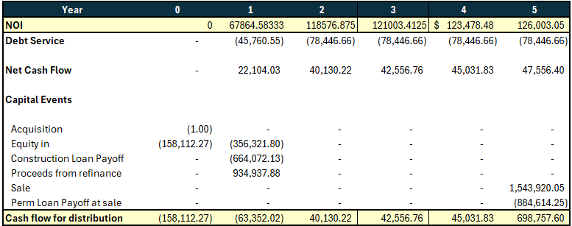
Projected Cashflows
IRR: 31.62%
MOIC: 2.18x
IRR: 15.84%
MOIC: 1.89x
Levered
Unlevered
Market Overview
Financials
Risk Analysis
Final Recommendation
Market Overview
Development Plan
Development Plan
Financials
Risk Analysis
Final Recommendation

Slide 23
Project Timeline
2025
Jan
2026
Jan
2027
Jan
2028
Jan
2029
Jan
2030
Jan
2031
Jan
Jun
Jun
Jun
Jun
Jun
Jun
Permits/City Approval
Construction
Lease-Up
Stabilization
Disposition
Market Overview
Development Plan
Financials
Risk Analysis
Final Recommendation
Market Overview
Development Plan
Financials
Risk Analysis
Final Recommendation

Slide 24
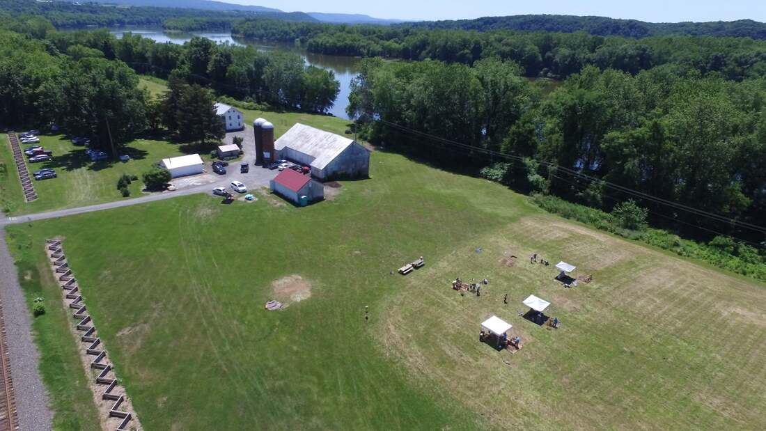
Risk Analysis

Slide 25
Scenario Analysis
Assumptions
Bear Case
Base Case
Bull Case
Exit Cap Rate
Vacancy
Retail Rent Growth
Construction Period
Hold Period
9.00%
5.00%
0.00%
12 Months
72
8.30%
5.00%
2.00%
6 Months
60
7.00%
5.00%
4.00%
4 Months
48
Bear Returns
Base Returns
Bull Returns
IRR: 19.08%
MOIC: 2.04x
IRR: 31.62%
MOIC: 2.18x
IRR: 56.49%
MOIC: 5.96x
Market Overview
Development Plan
Financials
Risk Analysis
Final Recommendation

Slide 26
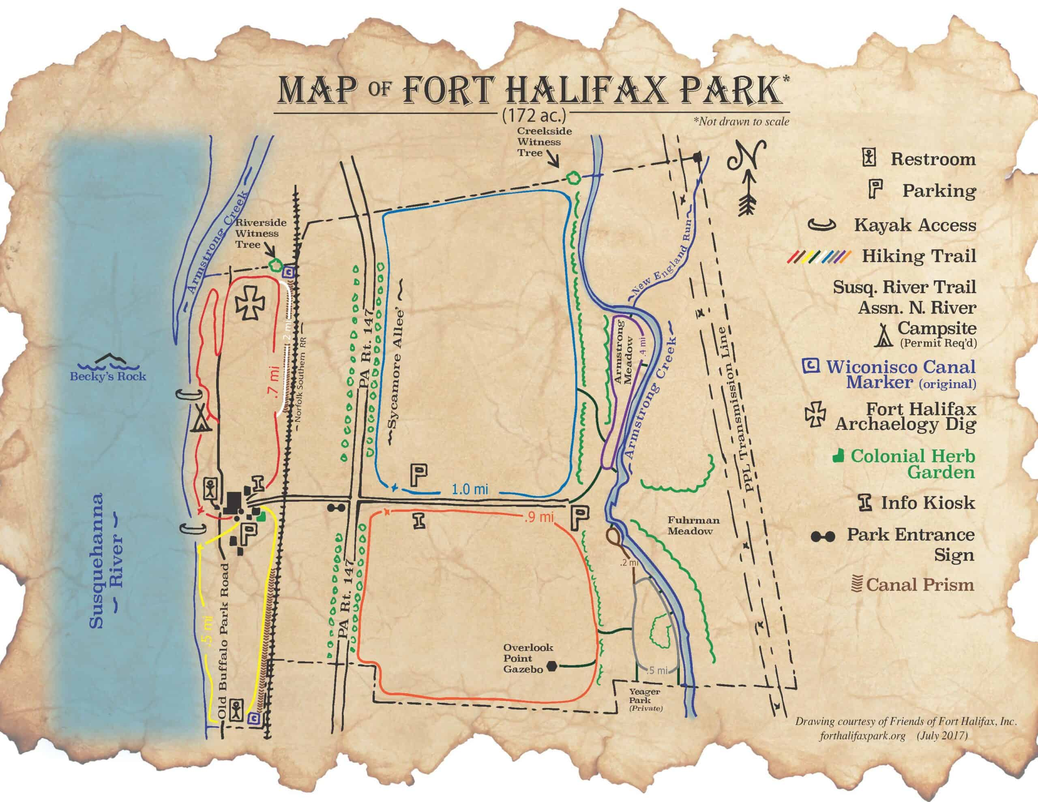
Retail Tenant
Risks
Struggle to sign leases
Low population (-1.37% growth rate of population since 2020)
Location
Expand customer reach past the local population
Experiential dining / cooking classes when restaurants closed
Risks & Mitigations
Key Risk
Low Population (-1.37% growth rate of population since 2020)
Flood Risk
Construction Delays
Limited Grant Money Awarded
Mitigations
Expand customer reach past the local population
Experiential dining/cooking classes when restaurants closed
Built on an elevated surface
Construction insurance
Account for half award
Market Overview
Development Plan
Financials
Risk Analysis
Final Recommendation
Risk Analysis

Slide 27
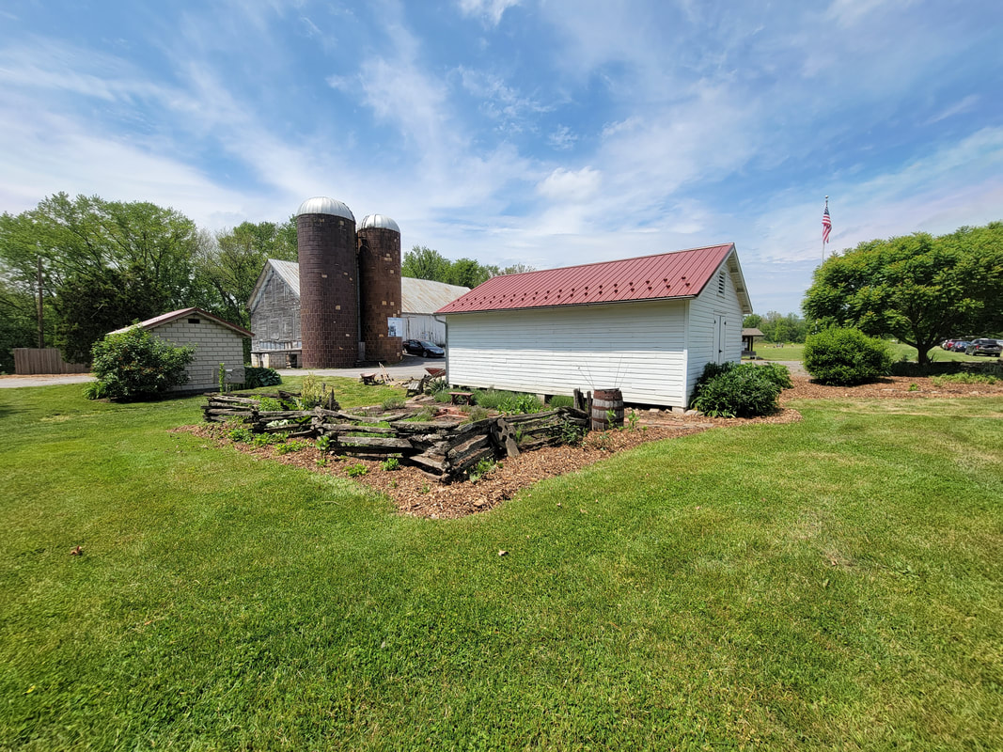
Sensitivity Analysis
Hold Period
Levered IRR | 3 | 4 | 5 | 6 | 7
7.70% | 54.20% | 45.10% | 39.71% | 36.13% | 33.60%
8.00% | 46.85% | 39.32% | 35.32% | 32.44% | 30.41%
8.30% | 40.55% | 34.96% | 31.76% | 29.36% | 27.76%
8.60% | 35.10% | 30.95% | 28.45% | 26.74% | 25.51%
9.00% | 28.86% | 26.39% | 23.78% | 23.78% | 22.99%
Exit Cap
31.62%
Market Overview
Development Plan
Financials
Risk Analysis
Final Recommendation
Market Overview
Development Plan
Financials
Risk Analysis
Market Overview
Development Plan
Financials
Risk Analysis
Final Recommendation
Market Overview
Development Plan
Financials
Risk Analysis
Final Recommendation
Risk Analysis
Final Recommendation
Risk Analysis

Slide 28
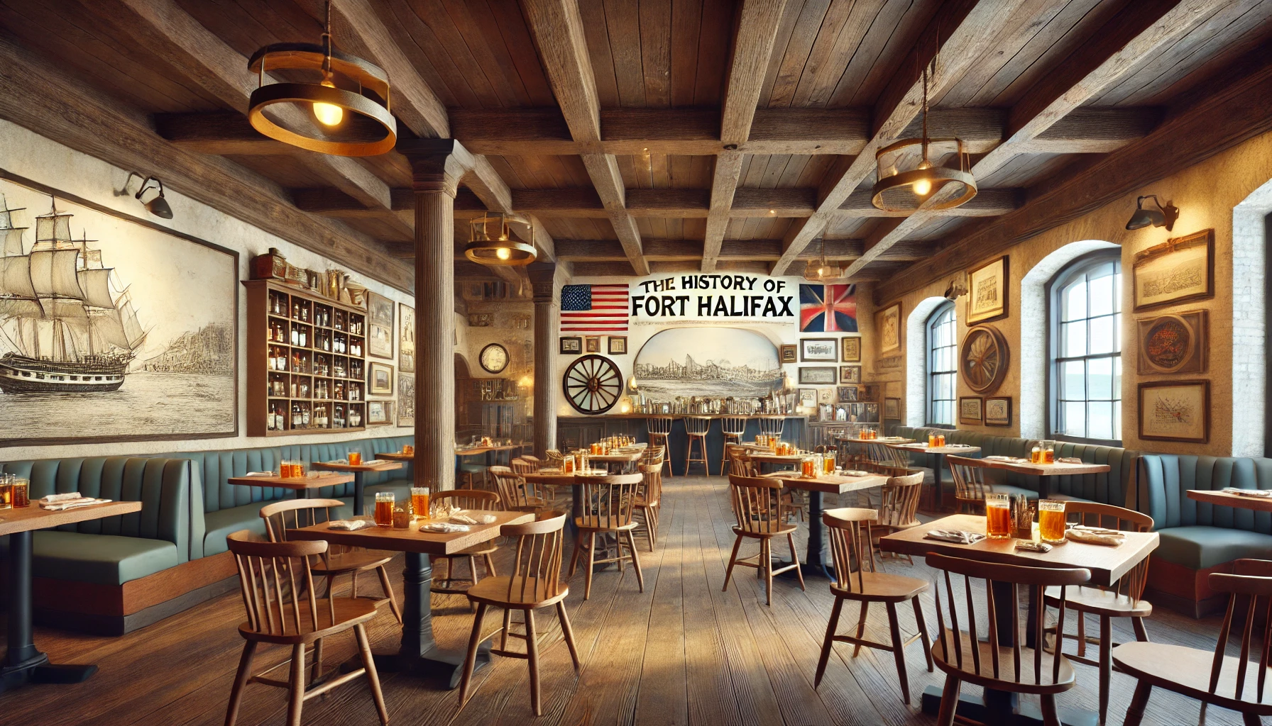
Final Recommendation

Slide 29
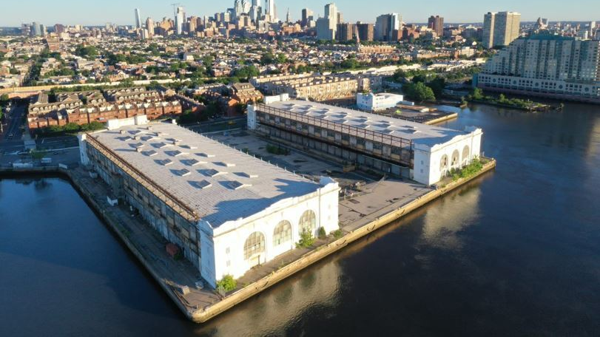
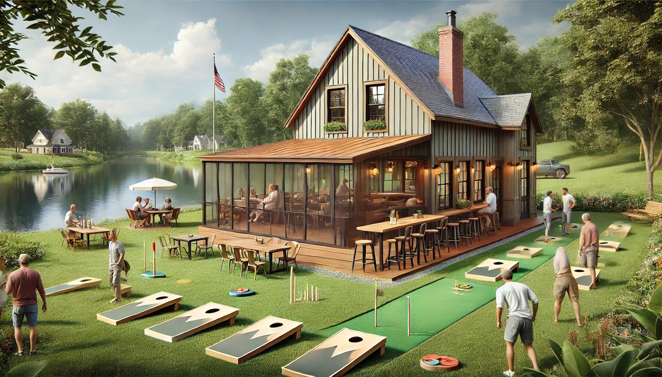
Project Returns
Investment Overview:
Opportunity to develop a historical tavern right off of Pennsylvania’s Susquehanna River
We recommend a 5-year hold and disposition
31.62%
Project IRR
10.80%
Yield on Cost
2.18x
MOIC
Value at Disposition
$1,543,920
Fort Halifax Tavern
Market Overview
Development Plan
Financials
Risk Analysis
Final Recommendation

Slide 30

Thank You!
Q & A

Slide 31
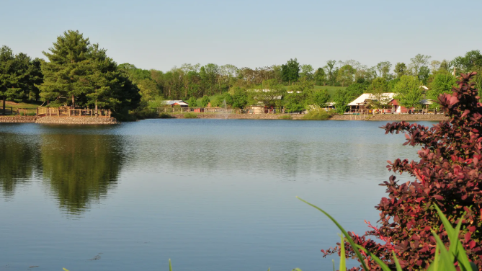
Appendix

Slide 32
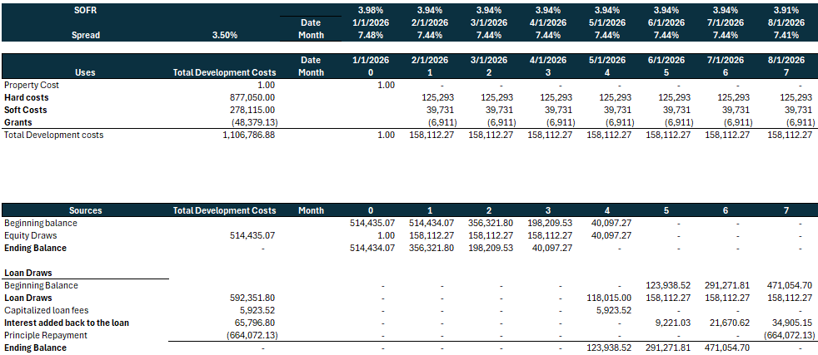
Draw Schedule

Slide 33
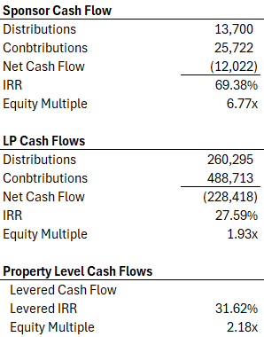
Partnership Structure
Market Overview
Development Plan
Financials
Risk Analysis
Final Recommendation

